Slide 1
Fourier Transform
DFT, FFT

Slide 2
Outline and Reading
Polynomials
Representation
Evaluation
Primitive Roots of Unity
Discrete Fourier Transform
FFT Algorithm
Time Analysis
Integer Multiplication

Slide 3
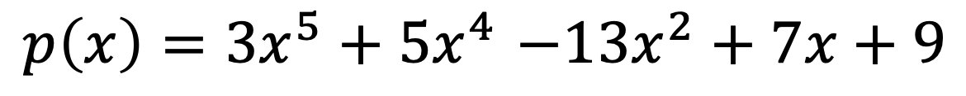
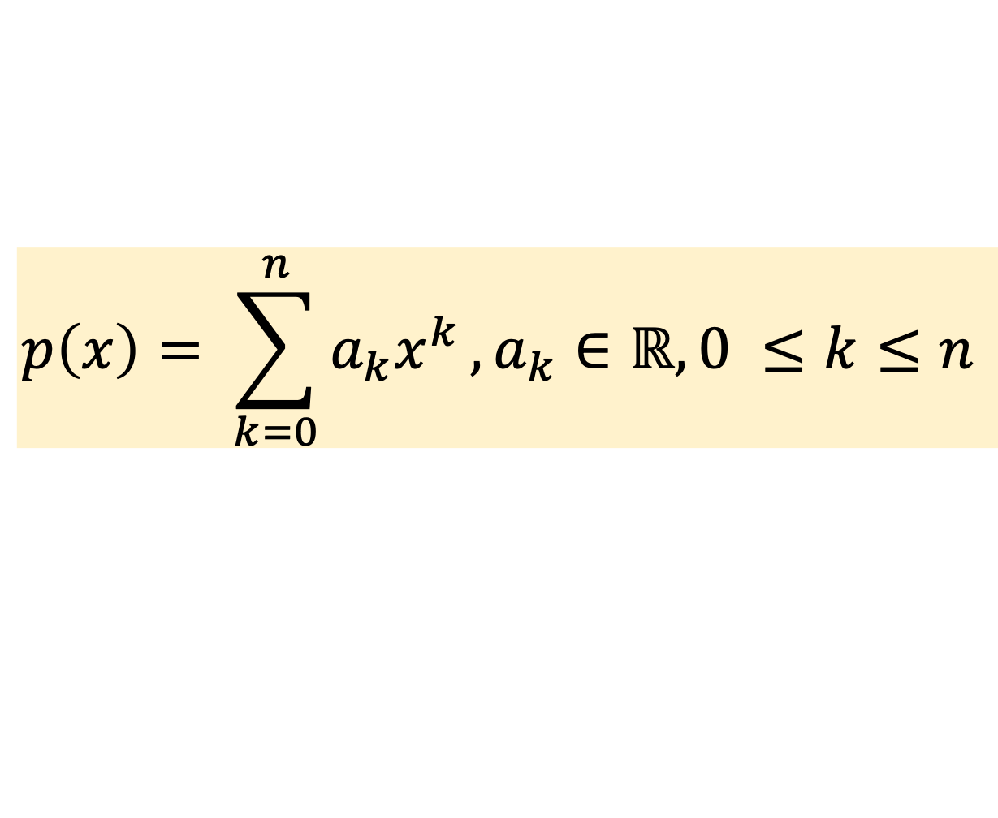
Polynomials
Polynomial:
Generic Polynomial Equation
$p\left(x\right)=3x^{5}+5x^{4}$ $−13x^{2}+7x+9$
$$p\left(x\right)=a_{n}x^{n}+a_{n−1}x^{n−1}+…+a_{2}x^{2}+a_{1}x+a_{0}$$
$$p\left(x\right)= \sum_{k=0}^{n}{a_{k}x^{k}},a_{k}∈ℝ, 0 ≤k≤n$$

Slide 4
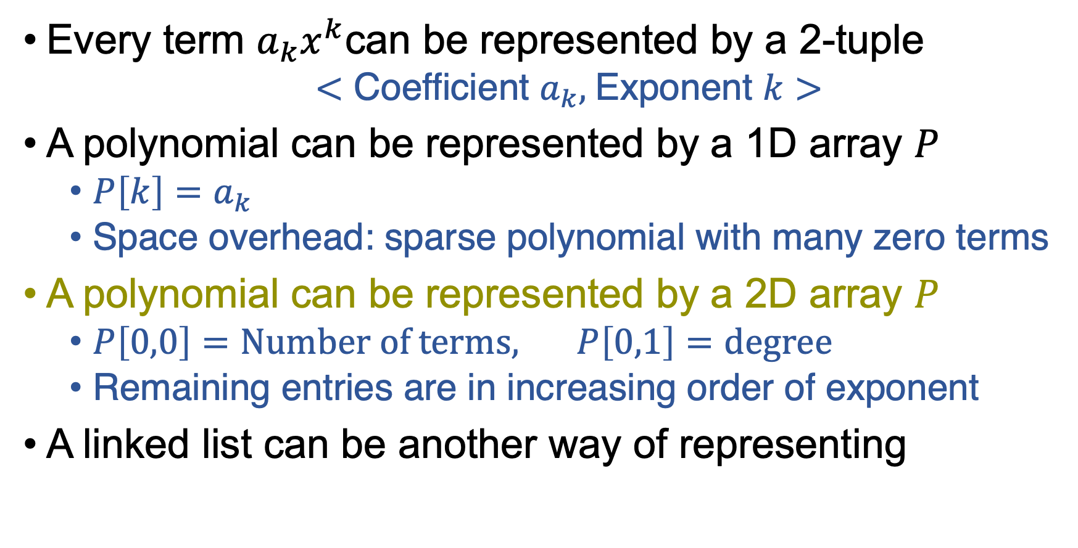
Representation
Every term $a_{k}x^{k}$can be represented by a 2-tuple
$<$ Coefficient $a_{k},$Exponent $k$ $>$
A polynomial can be represented by a 1D array $P$
$P\left[k\right]=a_{k}$
Space overhead: sparse polynomial with many zero terms
A polynomial can be represented by a 2D array $P$
$P\left[0,0\right]=\text{Number} \text{of} \text{terms}\text{,} P\left[0,1\right]=\text{degree}$
Remaining entries are in increasing order of exponent
A linked list can be another way of representing

Slide 5

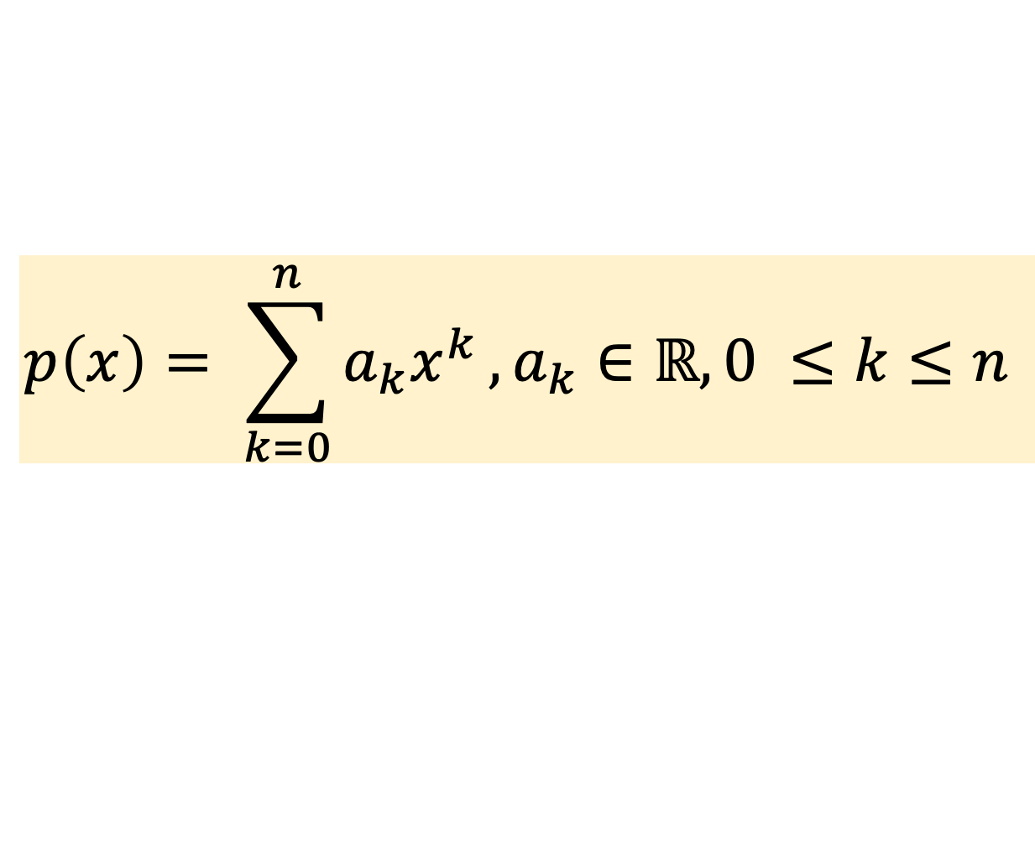
Evaluating a Polynomial
What is value for a given value of $x$?
$$p\left(x\right)=a_{n}x^{n}+a_{n−1}x^{n−1}+…+a_{2}x^{2}+a_{1}x+a_{0}$$
$$p\left(x\right)= \sum_{k=0}^{n}{a_{k}x^{k}},a_{k}∈ℝ, 0 ≤k≤n$$
How many multiplications?

Slide 6
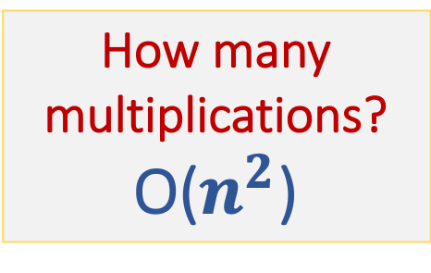
Evaluating a Polynomial
What is value for a given value of $x$?
$$p\left(x\right)=a_{n}x^{n}+a_{n−1}x^{n−1}+…+a_{2}x^{2}+a_{1}x+a_{0}$$
$$p\left(x\right)= \sum_{k=0}^{n}{a_{k}x^{k}},a_{k}∈ℝ, 0 ≤k≤n$$
How many multiplications?
O($n^{2}$)

Slide 7
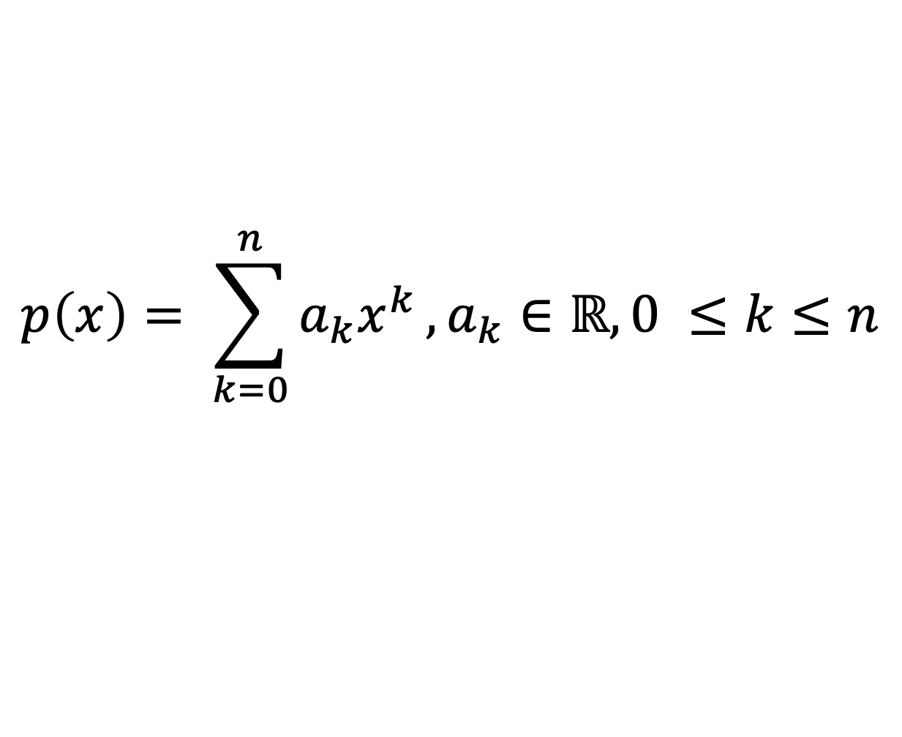
Polynomial Evaluation
Horner’s Rule:
A better way of evaluation?
Rearrange terms of polynomial
$$p\left(x\right)= \sum_{k=0}^{n}{a_{k}x^{k}},a_{k}∈ℝ, 0 ≤k≤n$$
$$p\left(x\right)=a_{n}x^{n}+a_{n−1}x^{n−1}+…+a_{2}x^{2}+a_{1}x+a_{0}$$
$p\left(x\right)=(\left(.. \left( a_{n}x+a_{n−1}\right)x+…+a_{2}\right)x+a_{1})x+a_{0}$)

Slide 8
Polynomial Evaluation
Horner’s Rule:
A better way of evaluation?
Rearrange terms of polynomial
How many multiplications?
$$p\left(x\right)= \sum_{k=0}^{n}{a_{k}x^{k}},a_{k}∈ℝ, 0 ≤k≤n$$
$$p\left(x\right)=a_{n}x^{n}+a_{n−1}x^{n−1}+…+a_{2}x^{2}+a_{1}x+a_{0}$$
$p\left(x\right)=(\left(.. \left( a_{n}x+a_{n−1}\right)x+…+a_{2}\right)x+a_{1})x+a_{0}$)

Slide 9
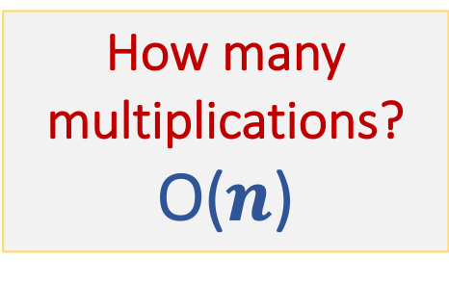
Polynomial Evaluation
Horner’s Rule:
A better way of evaluation?
Rearrange terms of polynomial
How many multiplications?
O($n$)
$$p\left(x\right)= \sum_{k=0}^{n}{a_{k}x^{k}},a_{k}∈ℝ, 0 ≤k≤n$$
$$p\left(x\right)=a_{n}x^{n}+a_{n−1}x^{n−1}+…+a_{2}x^{2}+a_{1}x+a_{0}$$
$p\left(x\right)=(\left(.. \left( a_{n}x+a_{n−1}\right)x+…+a_{2}\right)x+a_{1})x+a_{0}$)

Slide 10
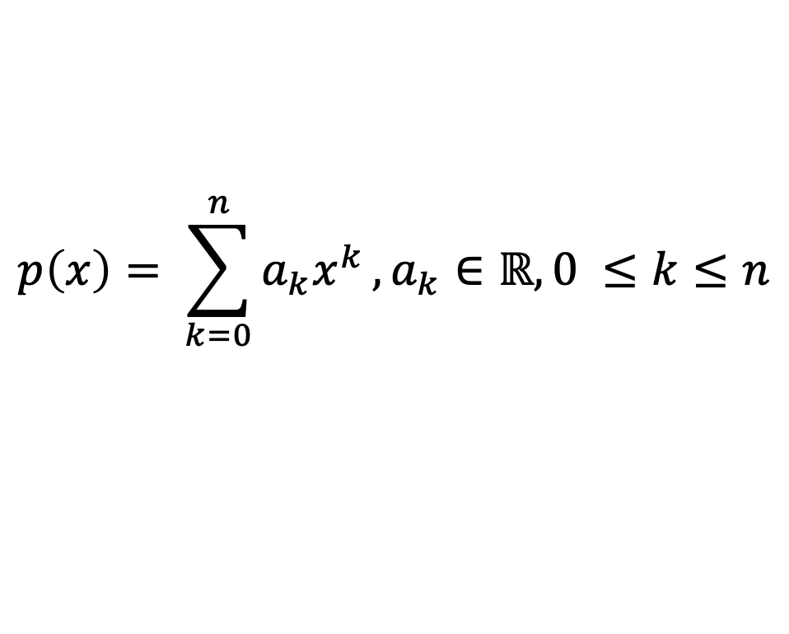

Polynomial Evaluation
Horner’s Rule:
$A=(a_{n},a_{n−1},…,a2,a_{1},a_{0})$
Eval(A,x):
If $n=0$, then return $a0$
Else,
Let $A’=A −\left[\text{last} \text{term}\right]= (a_{n},a_{n−1},…,a2,a_{1})$
return $a0+x∗$Eval($A’,x$)
$$p\left(x\right)= \sum_{k=0}^{n}{a_{k}x^{k}},a_{k}∈ℝ, 0 ≤k≤n$$
$p\left(x\right)=(\left(.. \left( a_{n}x+a_{n−1}\right)x+…+a_{2}\right)x+a_{1})x+a_{0}$)

Slide 11
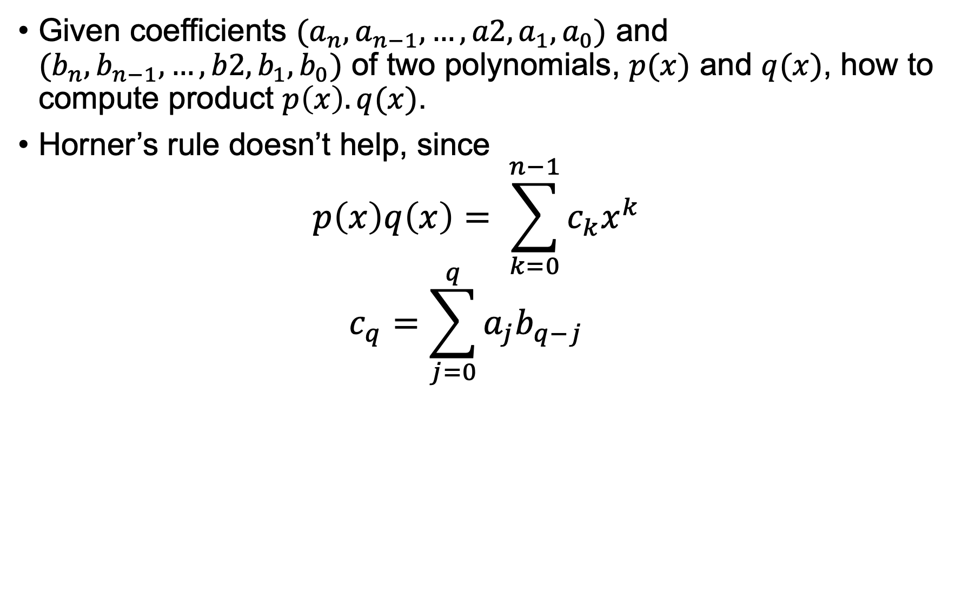
Polynomial Multiplication
Given coefficients $(a_{n},a_{n−1},…,a2,a_{1},a_{0})$ and $(b_{n},b_{n−1},…,b2,b_{1},b_{0})$ of two polynomials, $p(x)$ and $q(x)$, how to compute product $p\left(x\right).q(x)$.
Horner’s rule doesn’t help, since
$$p\left(x\right)q\left(x\right)= \sum_{k=0}^{n−1}{c_{k}x^{k}}$$
$$c_{q}=\sum_{j=0}^{q}{a_{j}b_{q−j}}$$

Slide 12
Polynomial Multiplication
Given coefficients $(a_{n},a_{n−1},…,a2,a_{1},a_{0})$ and $(b_{n},b_{n−1},…,b2,b_{1},b_{0})$ of two polynomials, $p(x)$ and $q(x)$, how to compute product $p\left(x\right).q(x)$.
Horner’s rule doesn’t help, since
$$p\left(x\right)q\left(x\right)= \sum_{k=0}^{n−1}{c_{k}x^{k}}$$
$$c_{q}=\sum_{j=0}^{q}{a_{j}b_{q−j}}$$
Complexity?

Slide 13
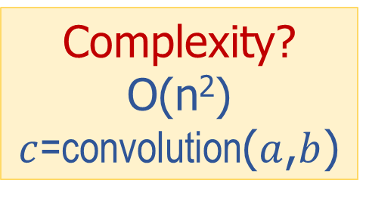
Polynomial Multiplication
Given coefficients $(a_{n},a_{n−1},…,a2,a_{1},a_{0})$ and $(b_{n},b_{n−1},…,b2,b_{1},b_{0})$ of two polynomials, $p(x)$ and $q(x)$, how to compute product $p\left(x\right).q(x)$.
Horner’s rule doesn’t help, since
$$p\left(x\right)q\left(x\right)= \sum_{k=0}^{n−1}{c_{k}x^{k}}$$
$$c_{q}=\sum_{j=0}^{q}{a_{j}b_{q−j}}$$
Complexity?
O(n²)
$c$=convolution($a$,$b$)

Slide 14

Polynomial Multiplication
Can polynomial multiplication be faster than O($n^{2}$)
Answer: Yes,
Solution: FFT or Fast Fourier Transform
Complexity: O($n$ log $n$)

Slide 15
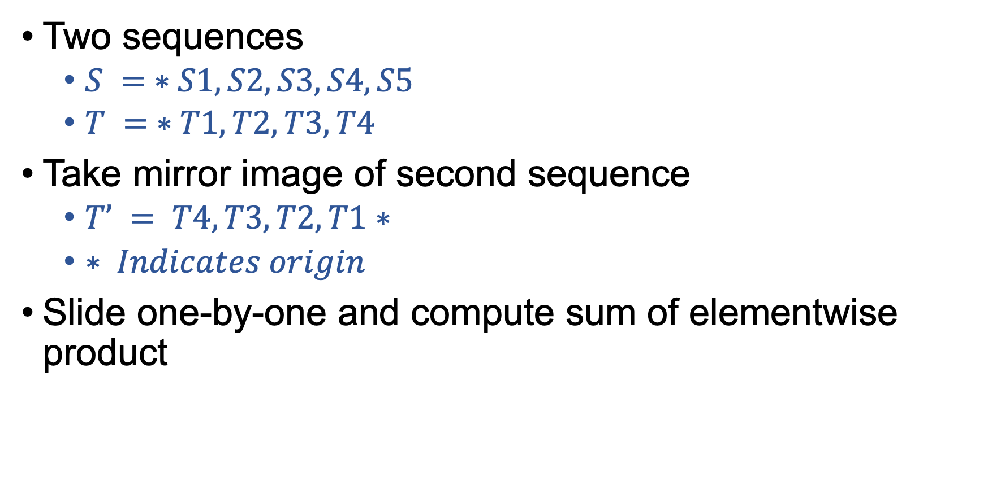
Convolution: 1D data
Two sequences
$S = ∗S1, S2, S3, S4, S5$
$T = ∗T1, T2, T3, T4$
Take mirror image of second sequence
$T’ = T4, T3, T2, T1∗$
$∗ Indicates origin$
Slide one-by-one and compute sum of elementwise product

Slide 16

Convolution Contd.
$S = 1, 2, 2, −1, 3, 4$
$T = 2, 3, −1, 7, 2$
$TR = 2, 7, −1, 3, 2$($TR$ is reflected $T$)

Slide 17

Reflect second sequence
$S = 1, 2, 2, −1, 3, 4$ (Series 1)
$T = 2, 3, −1, 7, 2$
$TR = 2, 7, −1, 3, 2$ (Series 2)

Slide 18

Reflect second sequence
$S = 0, 0, 0, 0, 0, 0, 1, 2, 2, −1, 3, 4$
$TR= 2, 7, −1, 3, 2, 0, 0, 0, 0, 0, 0, 0$

Slide 19

Slide and compute element wise product
$S = 0, 0, 0, 0, 0, 0, 1, 2, 2, −1, 3, 4$
$TR= 2, 7, −1, 3, 2, 0, 0, 0, 0, 0, 0, 0$
Product $=0∗0=0, t=0$

Slide 20

Slide and compute element wise product
$S = 0, 0, 0, 0, 0, 0, 1, 2, 2, −1, 3, 4$
$TR= 2, 7, −1, 3, 2, 0, 0, 0, 0, 0, 0$
Product = $0∗2=0, t=1$

Slide 21

Slide and compute element wise product
$S = 0, 0, 0, 0, 0, 0, 1, 2, 2, −1, 3, 4$
$TR= 2, 7, −1, 3, 2, 0, 0, 0, 0, 0, 0$
Product = $0∗3+1∗2 = 2 (t=2)$

Slide 22

Slide and compute element wise product
$S = 0, 0, 0, 0, 0, 0, 1, 2, 2, −1, 3, 4$
$TR= 2, 7, −1, 3, 2, 0, 0, 0, 0, 0, 0$
Product = $1∗3 + 2∗2 = 7 (t = 3)$

Slide 23

Slide and compute element wise product
$S = 0, 0, 0, 0, 0, 0, 1, 2, 2, −1, 3, 4$
$TR= 2, 7, −1, 3, 2, 0, 0, 0,$
Product = $1∗\left(−1\right)+ 2∗3 + 2∗2= 9 (t = 4)$

Slide 24

Slide and compute element wise product
$S = 0, 0, 0, 0, 0, 0, 1, 2, 2, −1, 3, 4$
$TR= 2, 7, −1, 3, 2, 0, 0, 0,$
Product = $1∗7 + 2∗\left(−1\right)+ 2∗3 +\left(−1\right)∗2$
$= 9 (t = 5)$

Slide 25

Slide and compute element wise product
$S = 0, 0, 0, 0, 0, 0, 1, 2, 2, −1, 3, 4$
$TR= 2, 7, −1, 3, 2, 0, 0, 0,$
Product = $1∗2 + 2∗7 + 2∗\left(−1\right)+\left(−1\right)∗3 + 3∗2$
$= 17 (t = 6)$

Slide 26

Slide and compute element wise product
$S = 0, 0, 0, 0, 0, 0, 1, 2, 2, −1, 3, 4$
$TR= 2, 7, −1, 3, 2, 0, 0, 0,$
Product = $2∗2 + 2∗7 +\left(−1\right)∗\left(−1\right)+ 3∗3 + 4∗2$
$= 36 (t = 7)$

Slide 27

Slide and compute element wise product
$S = 0, 0, 0, 0, 0, 0, 1, 2, 2, −1, 3, 4$
$TR= 2, 7, −1, 3, 2,$
Product = $2∗2 +\left(−1\right)∗7 + 3∗\left(−1\right)+ 4∗3$
$= 6 (t = 8)$

Slide 28

Slide and compute element wise product
$S = 0, 0, 0, 0, 0, 0, 1, 2, 2, −1, 3, 4$
$TR= 2, 7, −1, 3, 2,$
Product $= 2∗\left(−1\right)+ 3∗7 + 4∗(−1)$
$= 15 (t = 9)$

Slide 29

Slide and compute element wise product
$S = 0, 0, 0, 0, 0, 0, 1, 2, 2, −1, 3, 4$
$TR= 2, 7, −1, 3, 2,$
Product $= 2∗3 + 4∗7$
$= 34 (t = 10)$

Slide 30

Slide and compute element wise product
$S = 0, 0, 0, 0, 0, 0, 1, 2, 2, −1, 3, 4$
$TR= 2, 7, −1, 3, 2,$
Product $= 4∗2$
$6 (t = 8)$
$15 (t = 9)$
$34 (t = 10)$
$8 (t = 11)$

Slide 31

Slide and compute element wise product
$S = 0, 0, 0, 0, 0, 0, 1, 2, 2, −1, 3, 4$
$TR= 2, 7, −1, 3, 2,$
$S⋆TR=$
$= 8 (t = 11)$

Slide 32
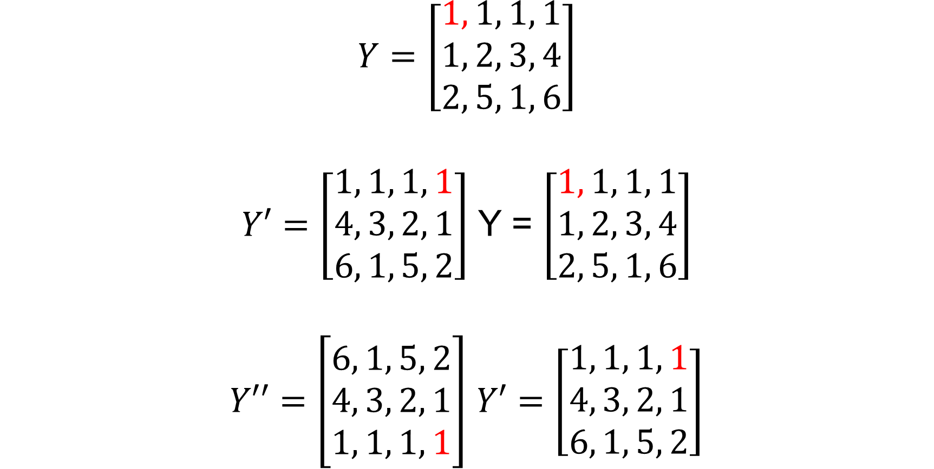
Reflection in 2D convolution
$$Y=\left[\begin{aligned}1, 1, 1, 1 \\ 1, 2, 3, 4 \\ 2, 5, 1, 6\end{aligned}\right]$$
$Y′=\left[\begin{aligned}1, 1, 1, 1 \\ 4, 3, 2, 1 \\ 6, 1, 5, 2\end{aligned}\right]$ Y = $\left[\begin{aligned}1, 1, 1, 1 \\ 1, 2, 3, 4 \\ 2, 5, 1, 6\end{aligned}\right]$
$Y′′=\left[\begin{aligned}6, 1, 5, 2 \\ 4, 3, 2, 1 \\ 1, 1, 1, 1\end{aligned}\right]$ $Y′=\left[\begin{aligned}1, 1, 1, 1 \\ 4, 3, 2, 1 \\ 6, 1, 5, 2\end{aligned}\right]$

Slide 33
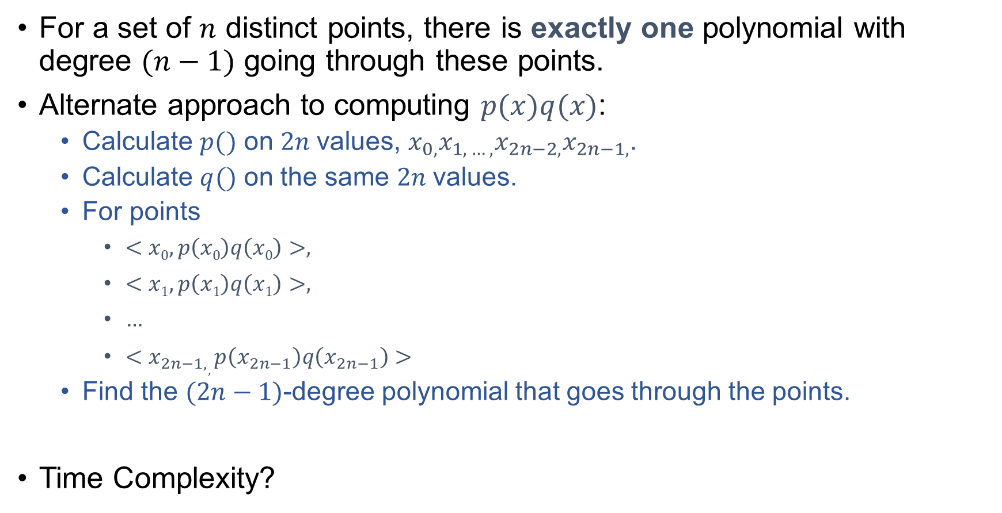
Polynomial Multiplication: Interpolation
For a set of $n$ distinct points, there is exactly one polynomial with degree $(n−1)$ going through these points.
Alternate approach to computing $p(x)q(x)$:
Calculate $p()$ on $2n$values, $x_{0,}x_{1, …, }x_{2n−2,}x_{2n−1,}$.
Calculate $q()$ on the same $2n$values.
For points
$<x0,p\left(x0\right)q\left(x0\right)>,$
$<x1,p\left(x1\right)q\left(x1\right)>,$
$…$
$<x_{2n−1,},p\left(x_{2n−1}\right)q\left(x_{2n−1}\right)>$
Find the $(2n−1)$-degree polynomial that goes through the points.
Time Complexity?

Slide 34
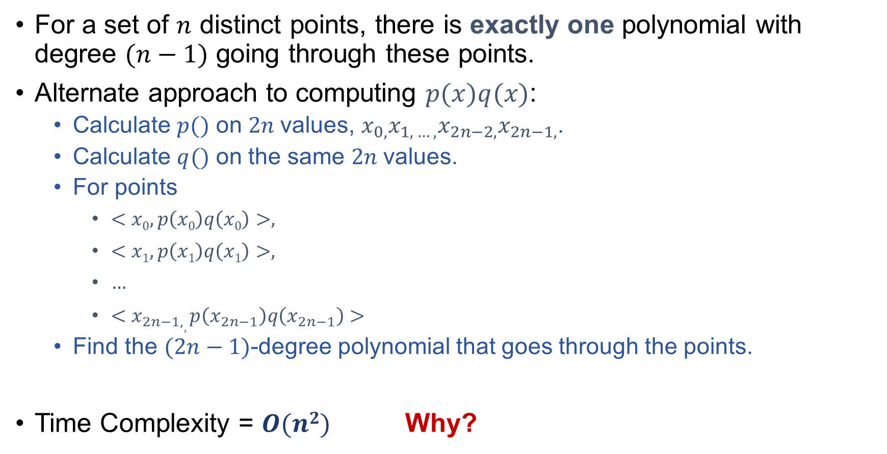
Polynomial Multiplication: Interpolation
For a set of $n$ distinct points, there is exactly one polynomial with degree $(n−1)$ going through these points.
Alternate approach to computing $p(x)q(x)$:
Calculate $p()$ on $2n$values, $x_{0,}x_{1, …, }x_{2n−2,}x_{2n−1,}$.
Calculate $q()$ on the same $2n$values.
For points
$<x0,p\left(x0\right)q\left(x0\right)>,$
$<x1,p\left(x1\right)q\left(x1\right)>,$
$…$
$<x_{2n−1,},p\left(x_{2n−1}\right)q\left(x_{2n−1}\right)>$
Find the $(2n−1)$-degree polynomial that goes through the points.
Time Complexity = $O(n2)$ Why?

Slide 35
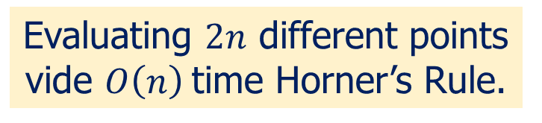

Polynomial Multiplication: Interpolation
For a set of $n$ distinct points, there is exactly one polynomial with degree $(n−1)$ going through these points.
Alternate approach to computing $p(x)q(x)$:
Calculate $p()$ on $2n$values, $x_{0,}x_{1, …, }x_{2n−2,}x_{2n−1,}$.
Calculate $q()$ on the same $2n$values.
For points
$<x0,p\left(x0\right)q\left(x0\right)>,$
$<x1,p\left(x1\right)q\left(x1\right)>,$
$…$
$<x_{2n−1,},p\left(x_{2n−1,}\right)q\left(x_{2n−1,}\right)>$
Find the $(2n−1)$-degree polynomial that goes through the points.
Time Complexity = $O(n2)$ Why?
Evaluating $2n$ different points vide $O\left(n\right)$time Horner’s Rule.

Slide 36
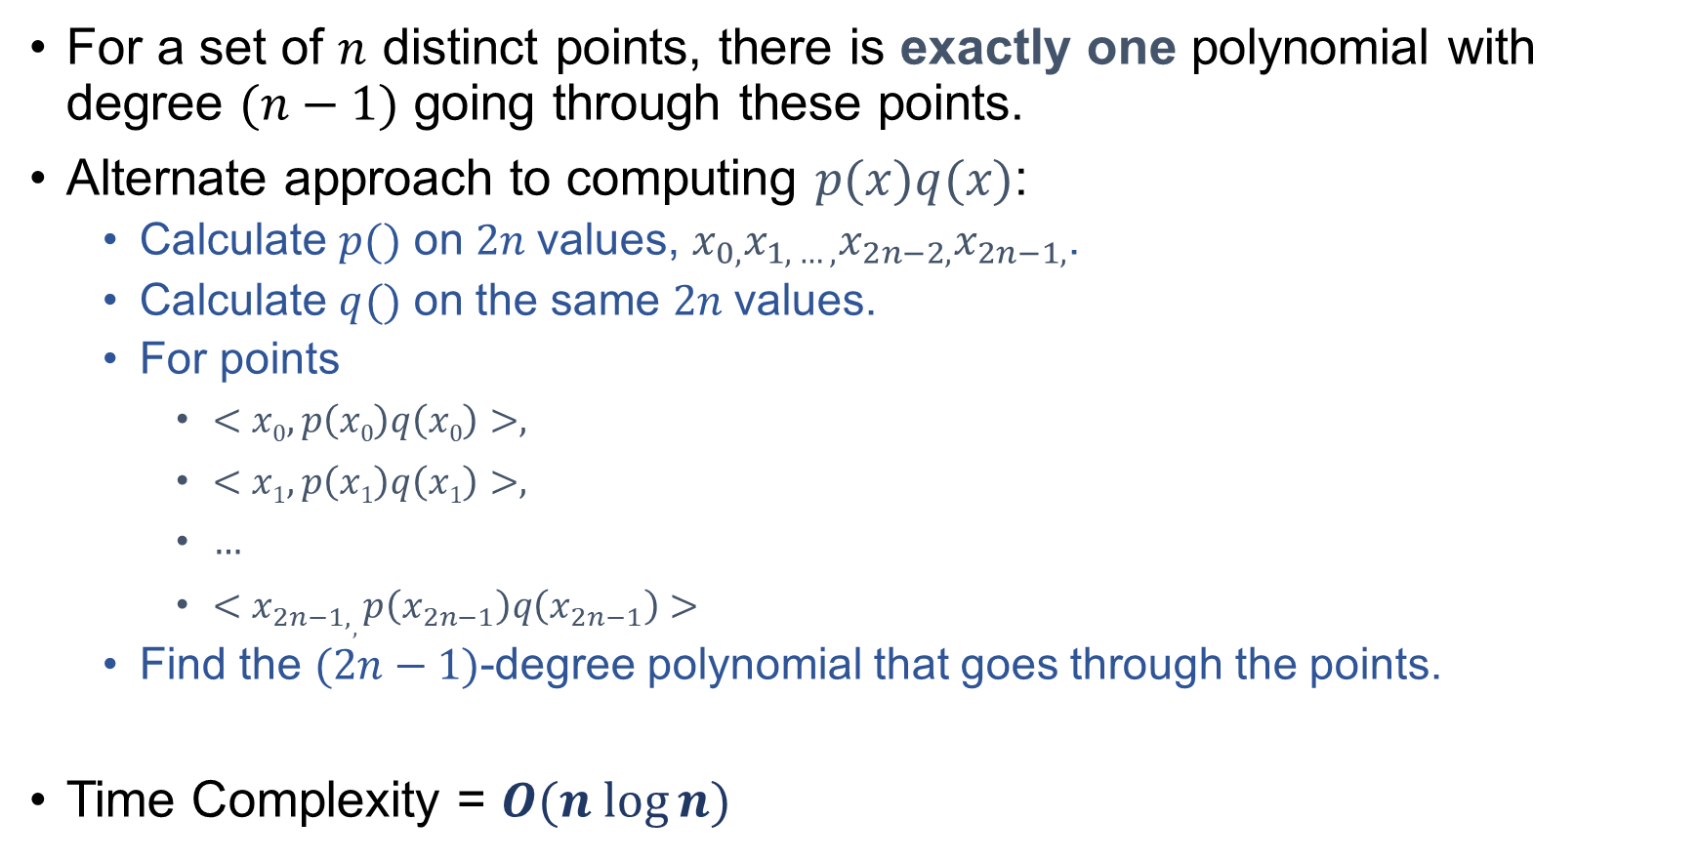
Polynomial Multiplication: Interpolation
For a set of $n$ distinct points, there is exactly one polynomial with degree $(n−1)$ going through these points.
Alternate approach to computing $p(x)q(x)$:
Calculate $p()$ on $2n$values, $x_{0,}x_{1, …, }x_{2n−2,}x_{2n−1,}$.
Calculate $q()$ on the same $2n$values.
For points
$<x0,p\left(x0\right)q\left(x0\right)>,$
$<x1,p\left(x1\right)q\left(x1\right)>,$
$…$
$<x_{2n−1,},p\left(x_{2n−1}\right)q\left(x_{2n−1}\right)>$
Find the $(2n−1)$-degree polynomial that goes through the points.
Time Complexity = $O(n log⁡n)$
Applying FFT to this problem

Slide 37

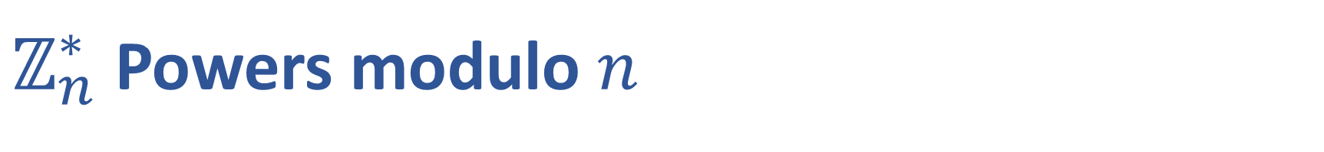
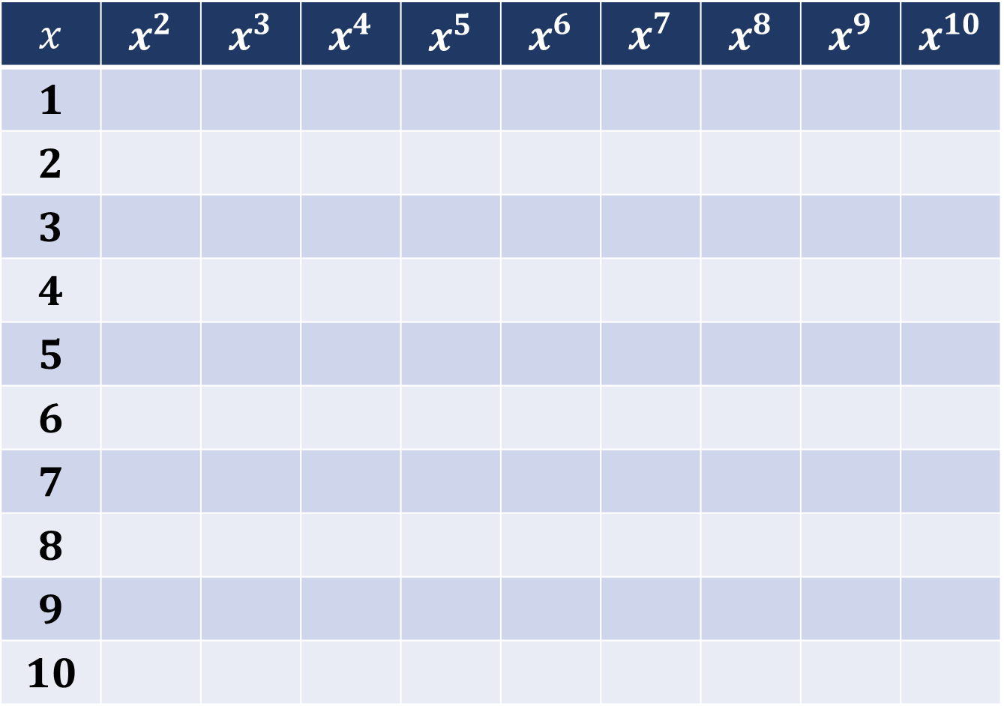
$ℤ_{n}^{∗}$Powers modulo $n$
$$ℤ_{n}^{∗}= \{1, 2, 3, 4, 5, 6, 7, 8, 9, 10\}$$
$$x$$ | $$x^{2}$$ | $$x^{3}$$ | $$x^{4}$$ | $$x^{5}$$ | $$x^{6}$$ | $$x^{7}$$ | $$x^{8}$$ | $$x^{9}$$ | $$x^{10}$$
$$1$$
$$2$$
$$3$$
$$4$$
$$5$$
$$6$$
$$7$$
$$8$$
$$9$$
$$10$$

Slide 38
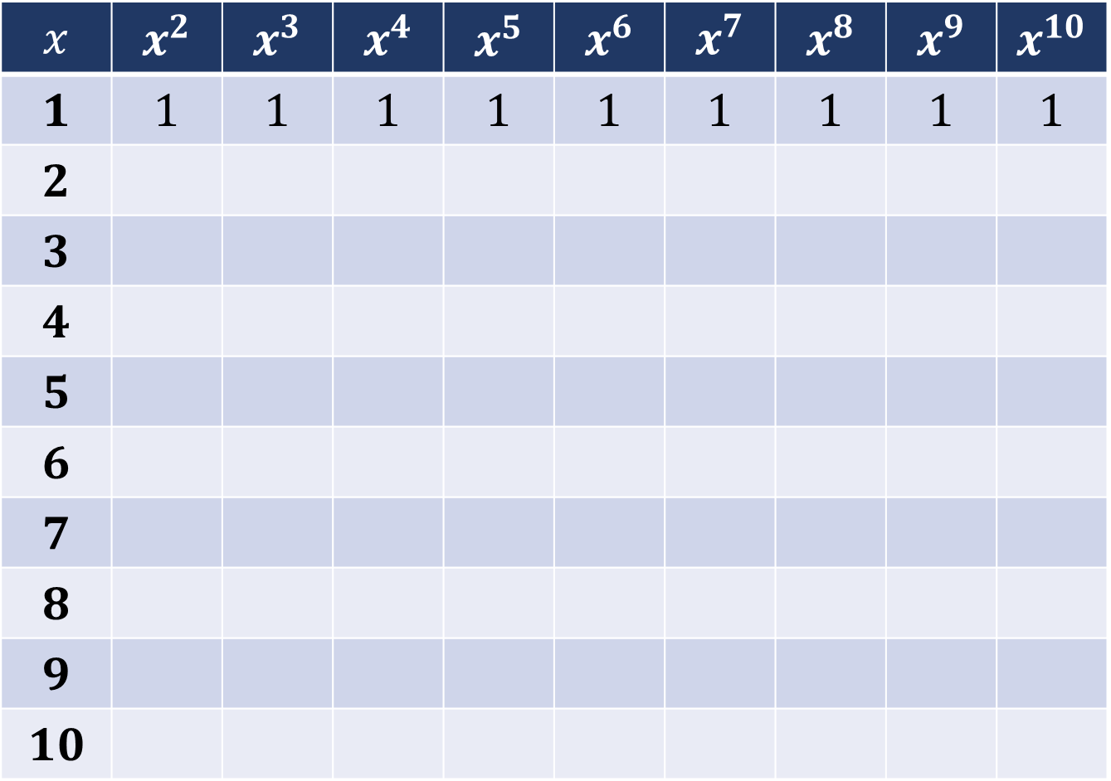
$ℤ_{n}^{∗}$Powers modulo $n$
$$ℤ_{n}^{∗}= \{1, 2, 3, 4, 5, 6, 7, 8, 9, 10\}$$
$$x$$ | $$x^{2}$$ | $$x^{3}$$ | $$x^{4}$$ | $$x^{5}$$ | $$x^{6}$$ | $$x^{7}$$ | $$x^{8}$$ | $$x^{9}$$ | $$x^{10}$$
$$1$$ | $$1$$ | $$1$$ | $$1$$ | $$1$$ | $$1$$ | $$1$$ | $$1$$ | $$1$$ | $$1$$
$$2$$
$$3$$
$$4$$
$$5$$
$$6$$
$$7$$
$$8$$
$$9$$
$$10$$

Slide 39
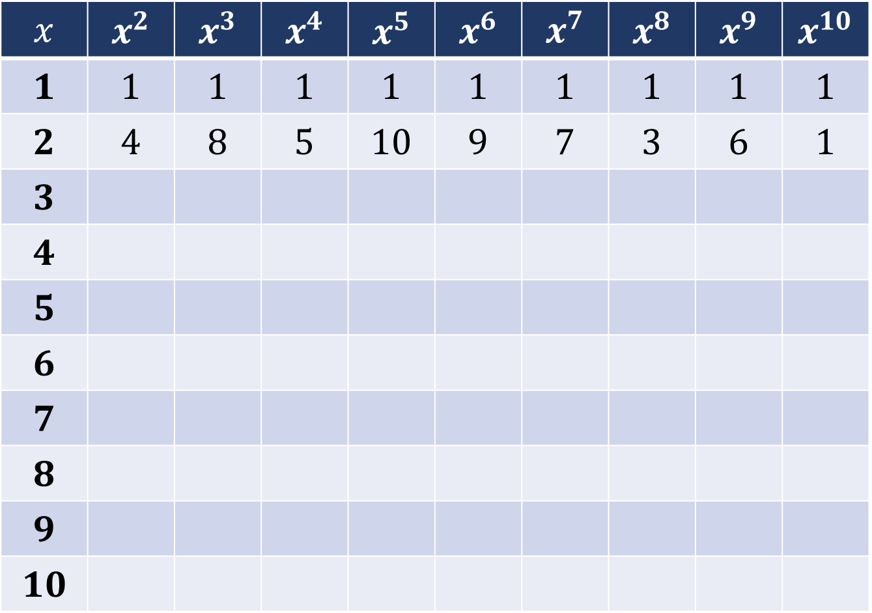
$ℤ_{n}^{∗}$Powers modulo $n$
$$ℤ_{n}^{∗}= \{1, 2, 3, 4, 5, 6, 7, 8, 9, 10\}$$
$$x$$ | $$x^{2}$$ | $$x^{3}$$ | $$x^{4}$$ | $$x^{5}$$ | $$x^{6}$$ | $$x^{7}$$ | $$x^{8}$$ | $$x^{9}$$ | $$x^{10}$$
$$1$$ | $$1$$ | $$1$$ | $$1$$ | $$1$$ | $$1$$ | $$1$$ | $$1$$ | $$1$$ | $$1$$
$$2$$ | $$4$$ | $$8$$ | $$5$$ | $$10$$ | $$9$$ | $$7$$ | $$3$$ | $$6$$ | $$1$$
$$3$$
$$4$$
$$5$$
$$6$$
$$7$$
$$8$$
$$9$$
$$10$$

Slide 40
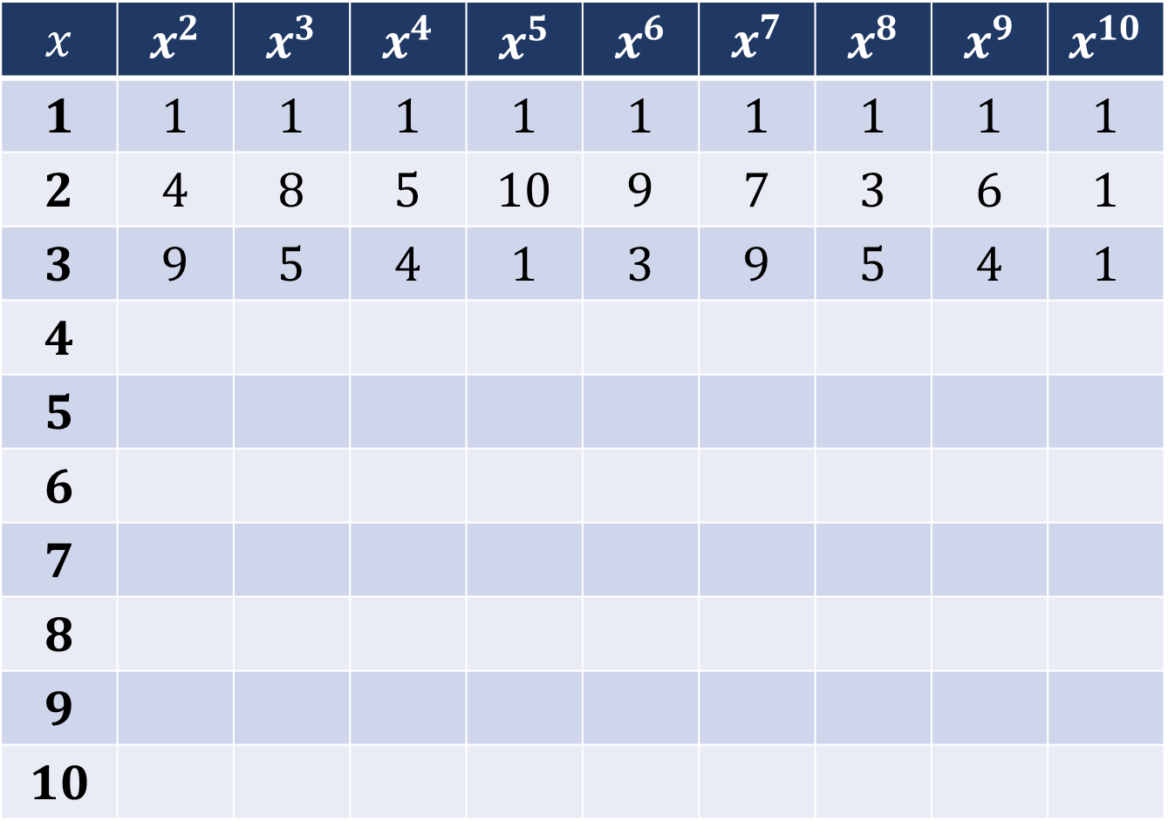
$ℤ_{n}^{∗}$Powers modulo $n$
$$ℤ_{n}^{∗}= \{1, 2, 3, 4, 5, 6, 7, 8, 9, 10\}$$
$$x$$ | $$x^{2}$$ | $$x^{3}$$ | $$x^{4}$$ | $$x^{5}$$ | $$x^{6}$$ | $$x^{7}$$ | $$x^{8}$$ | $$x^{9}$$ | $$x^{10}$$
$$1$$ | $$1$$ | $$1$$ | $$1$$ | $$1$$ | $$1$$ | $$1$$ | $$1$$ | $$1$$ | $$1$$
$$2$$ | $$4$$ | $$8$$ | $$5$$ | $$10$$ | $$9$$ | $$7$$ | $$3$$ | $$6$$ | $$1$$
$$3$$ | $$9$$ | $$5$$ | $$4$$ | $$1$$ | $$3$$ | $$9$$ | $$5$$ | $$4$$ | $$1$$
$$4$$
$$5$$
$$6$$
$$7$$
$$8$$
$$9$$
$$10$$

Slide 41
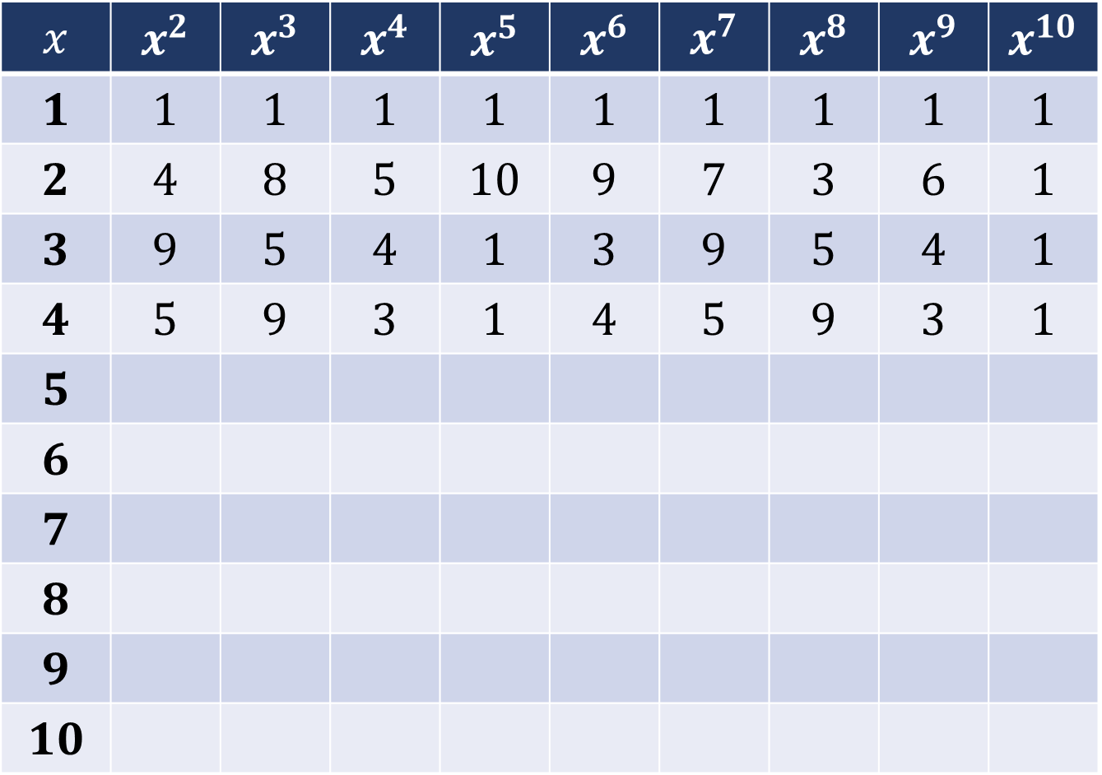
$ℤ_{n}^{∗}$Powers modulo $n$
$$ℤ_{n}^{∗}= \{1, 2, 3, 4, 5, 6, 7, 8, 9, 10\}$$
$$x$$ | $$x^{2}$$ | $$x^{3}$$ | $$x^{4}$$ | $$x^{5}$$ | $$x^{6}$$ | $$x^{7}$$ | $$x^{8}$$ | $$x^{9}$$ | $$x^{10}$$
$$1$$ | $$1$$ | $$1$$ | $$1$$ | $$1$$ | $$1$$ | $$1$$ | $$1$$ | $$1$$ | $$1$$
$$2$$ | $$4$$ | $$8$$ | $$5$$ | $$10$$ | $$9$$ | $$7$$ | $$3$$ | $$6$$ | $$1$$
$$3$$ | $$9$$ | $$5$$ | $$4$$ | $$1$$ | $$3$$ | $$9$$ | $$5$$ | $$4$$ | $$1$$
$$4$$ | $$5$$ | $$9$$ | $$3$$ | $$1$$ | $$4$$ | $$5$$ | $$9$$ | $$3$$ | $$1$$
$$5$$
$$6$$
$$7$$
$$8$$
$$9$$
$$10$$

Slide 42
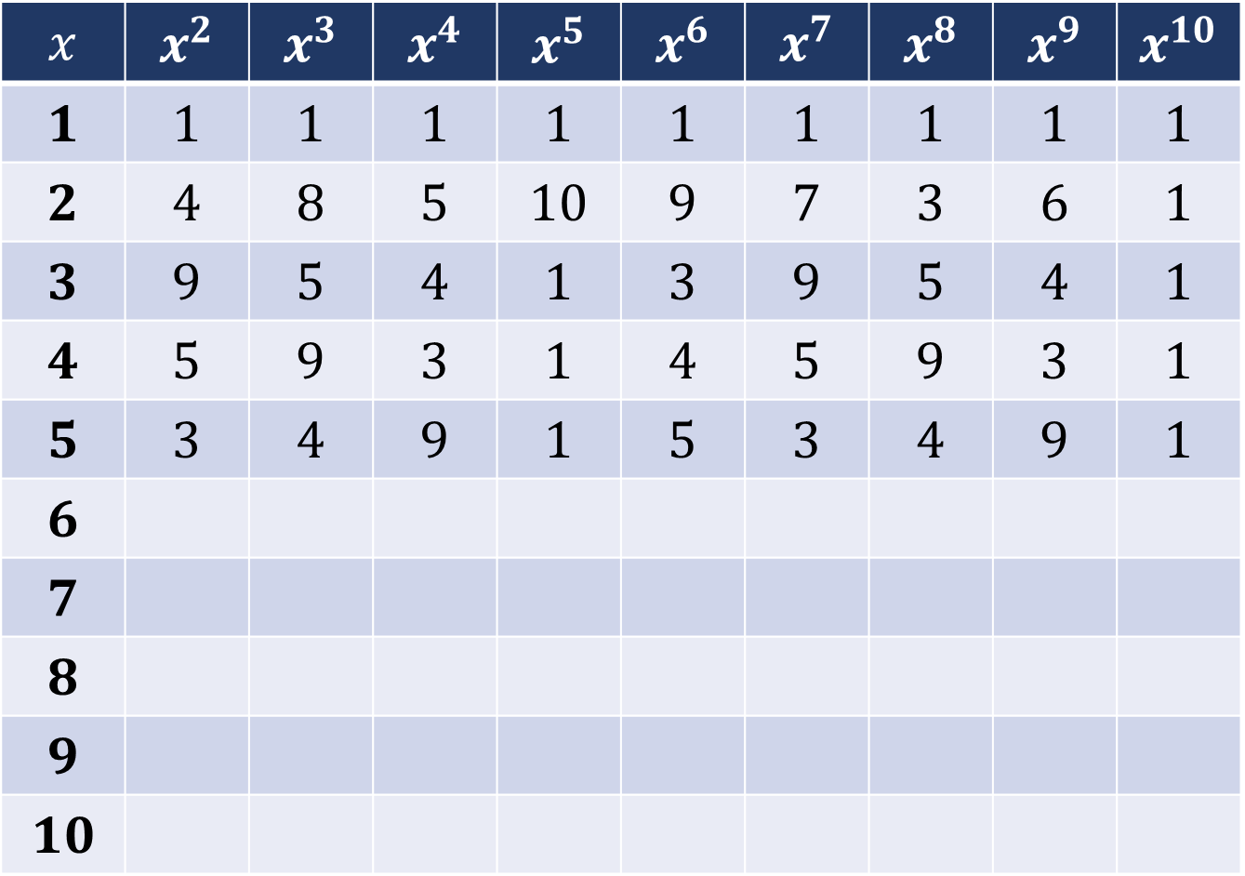
$ℤ_{n}^{∗}$Powers modulo $n$
$$ℤ_{n}^{∗}= \{1, 2, 3, 4, 5, 6, 7, 8, 9, 10\}$$
$$x$$ | $$x^{2}$$ | $$x^{3}$$ | $$x^{4}$$ | $$x^{5}$$ | $$x^{6}$$ | $$x^{7}$$ | $$x^{8}$$ | $$x^{9}$$ | $$x^{10}$$
$$1$$ | $$1$$ | $$1$$ | $$1$$ | $$1$$ | $$1$$ | $$1$$ | $$1$$ | $$1$$ | $$1$$
$$2$$ | $$4$$ | $$8$$ | $$5$$ | $$10$$ | $$9$$ | $$7$$ | $$3$$ | $$6$$ | $$1$$
$$3$$ | $$9$$ | $$5$$ | $$4$$ | $$1$$ | $$3$$ | $$9$$ | $$5$$ | $$4$$ | $$1$$
$$4$$ | $$5$$ | $$9$$ | $$3$$ | $$1$$ | $$4$$ | $$5$$ | $$9$$ | $$3$$ | $$1$$
$$5$$ | $$3$$ | $$4$$ | $$9$$ | $$1$$ | $$5$$ | $$3$$ | $$4$$ | $$9$$ | $$1$$
$$6$$
$$7$$
$$8$$
$$9$$
$$10$$

Slide 43
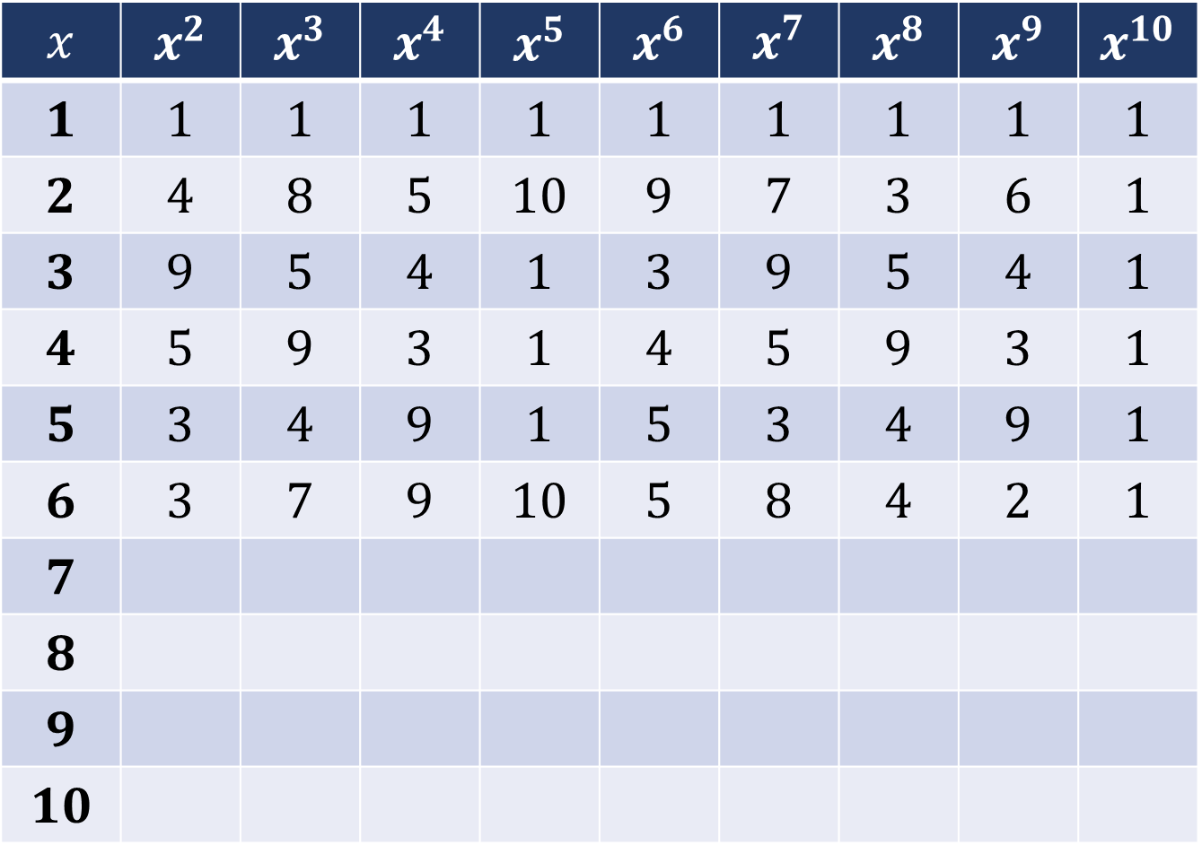
$ℤ_{n}^{∗}$Powers modulo $n$
$$ℤ_{n}^{∗}= \{1, 2, 3, 4, 5, 6, 7, 8, 9, 10\}$$
$$x$$ | $$x^{2}$$ | $$x^{3}$$ | $$x^{4}$$ | $$x^{5}$$ | $$x^{6}$$ | $$x^{7}$$ | $$x^{8}$$ | $$x^{9}$$ | $$x^{10}$$
$$1$$ | $$1$$ | $$1$$ | $$1$$ | $$1$$ | $$1$$ | $$1$$ | $$1$$ | $$1$$ | $$1$$
$$2$$ | $$4$$ | $$8$$ | $$5$$ | $$10$$ | $$9$$ | $$7$$ | $$3$$ | $$6$$ | $$1$$
$$3$$ | $$9$$ | $$5$$ | $$4$$ | $$1$$ | $$3$$ | $$9$$ | $$5$$ | $$4$$ | $$1$$
$$4$$ | $$5$$ | $$9$$ | $$3$$ | $$1$$ | $$4$$ | $$5$$ | $$9$$ | $$3$$ | $$1$$
$$5$$ | $$3$$ | $$4$$ | $$9$$ | $$1$$ | $$5$$ | $$3$$ | $$4$$ | $$9$$ | $$1$$
$$6$$ | $$3$$ | $$7$$ | $$9$$ | $$10$$ | $$5$$ | $$8$$ | $$4$$ | $$2$$ | $$1$$
$$7$$
$$8$$
$$9$$
$$10$$

Slide 44
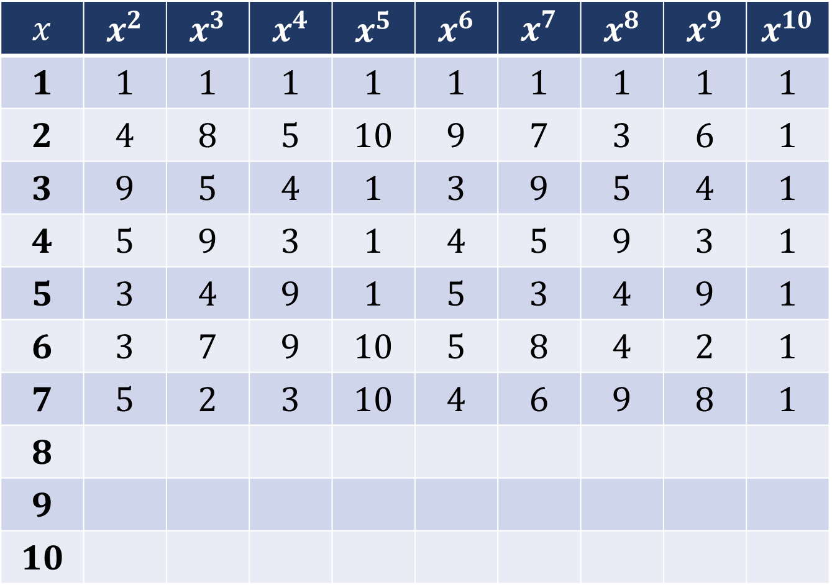
$ℤ_{n}^{∗}$Powers modulo $n$
$$ℤ_{n}^{∗}= \{1, 2, 3, 4, 5, 6, 7, 8, 9, 10\}$$
$$x$$ | $$x^{2}$$ | $$x^{3}$$ | $$x^{4}$$ | $$x^{5}$$ | $$x^{6}$$ | $$x^{7}$$ | $$x^{8}$$ | $$x^{9}$$ | $$x^{10}$$
$$1$$ | $$1$$ | $$1$$ | $$1$$ | $$1$$ | $$1$$ | $$1$$ | $$1$$ | $$1$$ | $$1$$
$$2$$ | $$4$$ | $$8$$ | $$5$$ | $$10$$ | $$9$$ | $$7$$ | $$3$$ | $$6$$ | $$1$$
$$3$$ | $$9$$ | $$5$$ | $$4$$ | $$1$$ | $$3$$ | $$9$$ | $$5$$ | $$4$$ | $$1$$
$$4$$ | $$5$$ | $$9$$ | $$3$$ | $$1$$ | $$4$$ | $$5$$ | $$9$$ | $$3$$ | $$1$$
$$5$$ | $$3$$ | $$4$$ | $$9$$ | $$1$$ | $$5$$ | $$3$$ | $$4$$ | $$9$$ | $$1$$
$$6$$ | $$3$$ | $$7$$ | $$9$$ | $$10$$ | $$5$$ | $$8$$ | $$4$$ | $$2$$ | $$1$$
$$7$$ | $$5$$ | $$2$$ | $$3$$ | $$10$$ | $$4$$ | $$6$$ | $$9$$ | $$8$$ | $$1$$
$$8$$
$$9$$
$$10$$

Slide 45
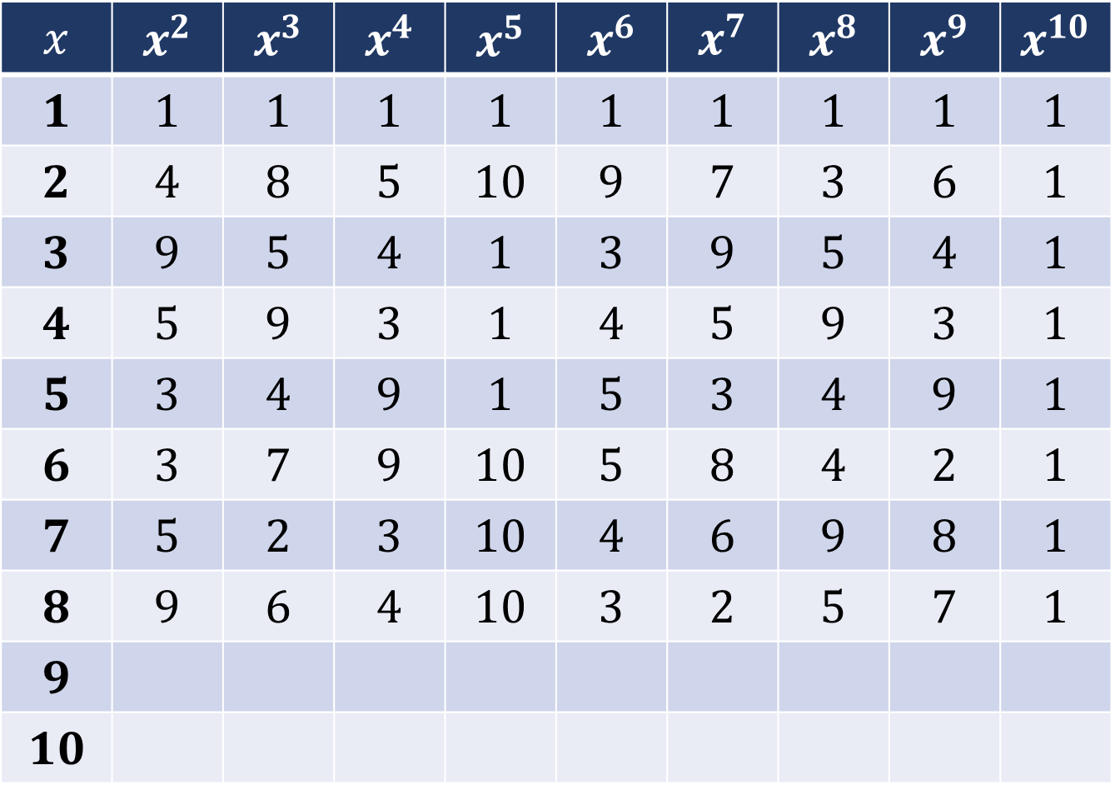
$ℤ_{n}^{∗}$Powers modulo $n$
$$ℤ_{n}^{∗}= \{1, 2, 3, 4, 5, 6, 7, 8, 9, 10\}$$
$$x$$ | $$x^{2}$$ | $$x^{3}$$ | $$x^{4}$$ | $$x^{5}$$ | $$x^{6}$$ | $$x^{7}$$ | $$x^{8}$$ | $$x^{9}$$ | $$x^{10}$$
$$1$$ | $$1$$ | $$1$$ | $$1$$ | $$1$$ | $$1$$ | $$1$$ | $$1$$ | $$1$$ | $$1$$
$$2$$ | $$4$$ | $$8$$ | $$5$$ | $$10$$ | $$9$$ | $$7$$ | $$3$$ | $$6$$ | $$1$$
$$3$$ | $$9$$ | $$5$$ | $$4$$ | $$1$$ | $$3$$ | $$9$$ | $$5$$ | $$4$$ | $$1$$
$$4$$ | $$5$$ | $$9$$ | $$3$$ | $$1$$ | $$4$$ | $$5$$ | $$9$$ | $$3$$ | $$1$$
$$5$$ | $$3$$ | $$4$$ | $$9$$ | $$1$$ | $$5$$ | $$3$$ | $$4$$ | $$9$$ | $$1$$
$$6$$ | $$3$$ | $$7$$ | $$9$$ | $$10$$ | $$5$$ | $$8$$ | $$4$$ | $$2$$ | $$1$$
$$7$$ | $$5$$ | $$2$$ | $$3$$ | $$10$$ | $$4$$ | $$6$$ | $$9$$ | $$8$$ | $$1$$
$$8$$ | $$9$$ | $$6$$ | $$4$$ | $$10$$ | $$3$$ | $$2$$ | $$5$$ | $$7$$ | $$1$$
$$9$$
$$10$$

Slide 46
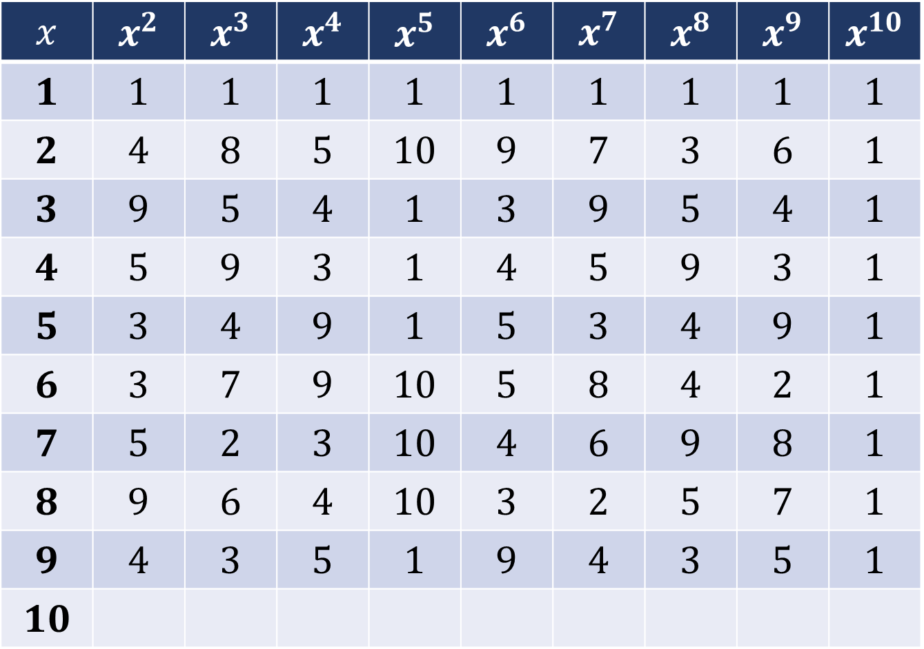
$ℤ_{n}^{∗}$Powers modulo $n$
$$ℤ_{n}^{∗}= \{1, 2, 3, 4, 5, 6, 7, 8, 9, 10\}$$
$$x$$ | $$x^{2}$$ | $$x^{3}$$ | $$x^{4}$$ | $$x^{5}$$ | $$x^{6}$$ | $$x^{7}$$ | $$x^{8}$$ | $$x^{9}$$ | $$x^{10}$$
$$1$$ | $$1$$ | $$1$$ | $$1$$ | $$1$$ | $$1$$ | $$1$$ | $$1$$ | $$1$$ | $$1$$
$$2$$ | $$4$$ | $$8$$ | $$5$$ | $$10$$ | $$9$$ | $$7$$ | $$3$$ | $$6$$ | $$1$$
$$3$$ | $$9$$ | $$5$$ | $$4$$ | $$1$$ | $$3$$ | $$9$$ | $$5$$ | $$4$$ | $$1$$
$$4$$ | $$5$$ | $$9$$ | $$3$$ | $$1$$ | $$4$$ | $$5$$ | $$9$$ | $$3$$ | $$1$$
$$5$$ | $$3$$ | $$4$$ | $$9$$ | $$1$$ | $$5$$ | $$3$$ | $$4$$ | $$9$$ | $$1$$
$$6$$ | $$3$$ | $$7$$ | $$9$$ | $$10$$ | $$5$$ | $$8$$ | $$4$$ | $$2$$ | $$1$$
$$7$$ | $$5$$ | $$2$$ | $$3$$ | $$10$$ | $$4$$ | $$6$$ | $$9$$ | $$8$$ | $$1$$
$$8$$ | $$9$$ | $$6$$ | $$4$$ | $$10$$ | $$3$$ | $$2$$ | $$5$$ | $$7$$ | $$1$$
$$9$$ | $$4$$ | $$3$$ | $$5$$ | $$1$$ | $$9$$ | $$4$$ | $$3$$ | $$5$$ | $$1$$
$$10$$

Slide 47
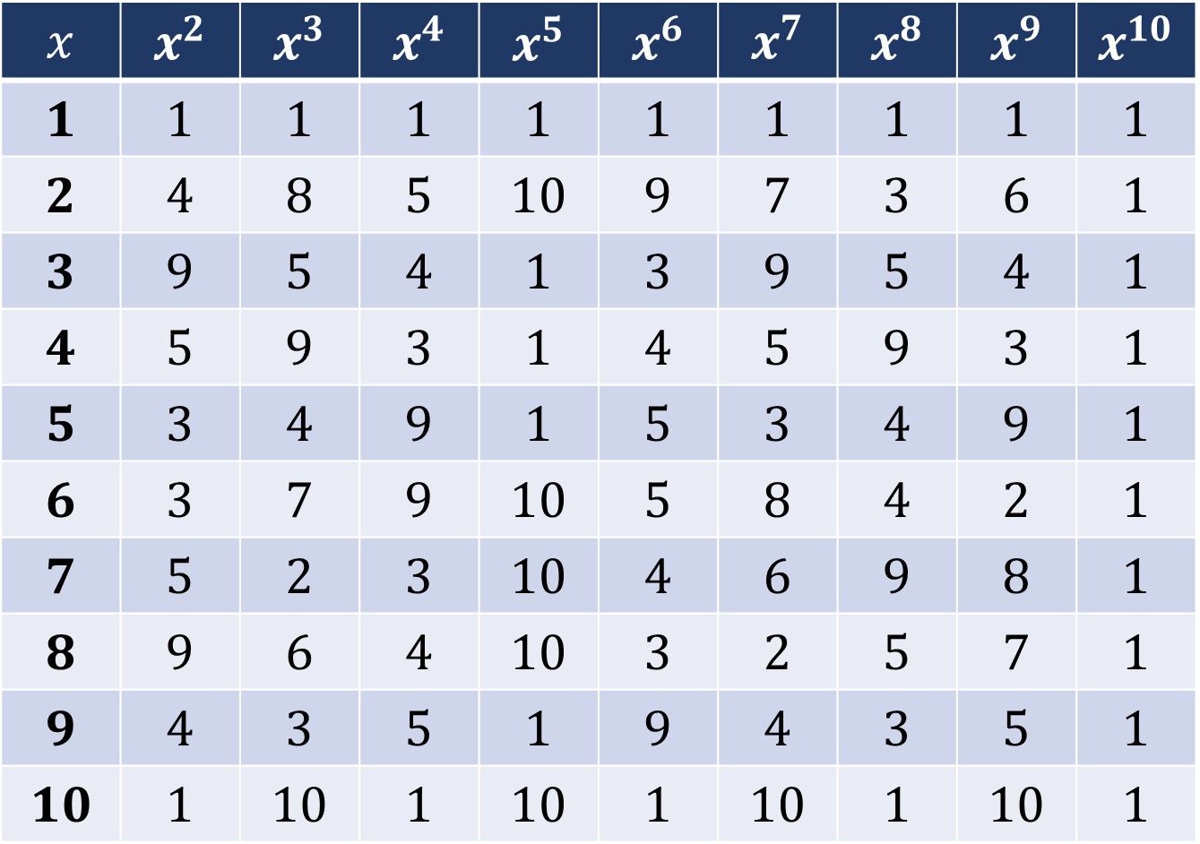
$ℤ_{n}^{∗}$Powers modulo $n$
$$ℤ_{n}^{∗}= \{1, 2, 3, 4, 5, 6, 7, 8, 9, 10\}$$
$$x$$ | $$x^{2}$$ | $$x^{3}$$ | $$x^{4}$$ | $$x^{5}$$ | $$x^{6}$$ | $$x^{7}$$ | $$x^{8}$$ | $$x^{9}$$ | $$x^{10}$$
$$1$$ | $$1$$ | $$1$$ | $$1$$ | $$1$$ | $$1$$ | $$1$$ | $$1$$ | $$1$$ | $$1$$
$$2$$ | $$4$$ | $$8$$ | $$5$$ | $$10$$ | $$9$$ | $$7$$ | $$3$$ | $$6$$ | $$1$$
$$3$$ | $$9$$ | $$5$$ | $$4$$ | $$1$$ | $$3$$ | $$9$$ | $$5$$ | $$4$$ | $$1$$
$$4$$ | $$5$$ | $$9$$ | $$3$$ | $$1$$ | $$4$$ | $$5$$ | $$9$$ | $$3$$ | $$1$$
$$5$$ | $$3$$ | $$4$$ | $$9$$ | $$1$$ | $$5$$ | $$3$$ | $$4$$ | $$9$$ | $$1$$
$$6$$ | $$3$$ | $$7$$ | $$9$$ | $$10$$ | $$5$$ | $$8$$ | $$4$$ | $$2$$ | $$1$$
$$7$$ | $$5$$ | $$2$$ | $$3$$ | $$10$$ | $$4$$ | $$6$$ | $$9$$ | $$8$$ | $$1$$
$$8$$ | $$9$$ | $$6$$ | $$4$$ | $$10$$ | $$3$$ | $$2$$ | $$5$$ | $$7$$ | $$1$$
$$9$$ | $$4$$ | $$3$$ | $$5$$ | $$1$$ | $$9$$ | $$4$$ | $$3$$ | $$5$$ | $$1$$
$$10$$ | $$1$$ | $$10$$ | $$1$$ | $$10$$ | $$1$$ | $$10$$ | $$1$$ | $$10$$ | $$1$$

Slide 48
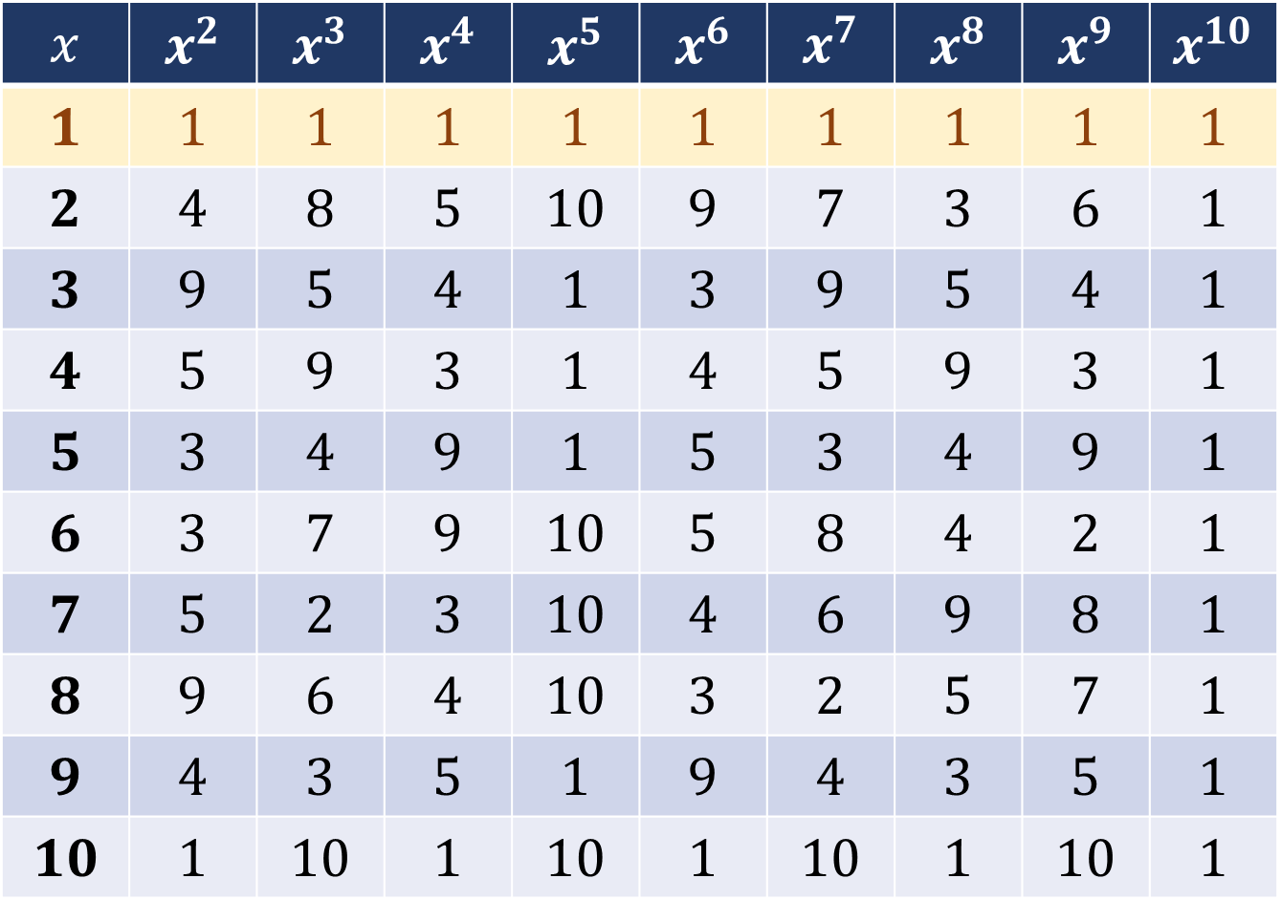
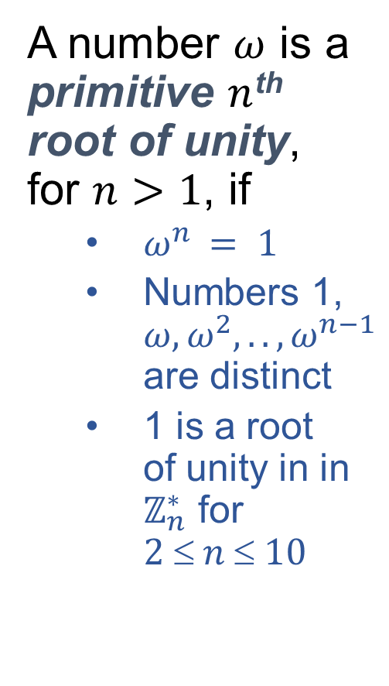
Primitive Roots of Unity
A number $ω$ is a primitive $n$^{th} root of unity, for $n>1$, if
$ω^{n} = 1$
Numbers 1, $ω,ω^{2}, ..,ω^{n−1}$ are distinct
1 is a root of unity in in $ℤ_{n}^{∗}$ for $2  n  10$
$$x$$ | $$x^{2}$$ | $$x^{3}$$ | $$x^{4}$$ | $$x^{5}$$ | $$x^{6}$$ | $$x^{7}$$ | $$x^{8}$$ | $$x^{9}$$ | $$x^{10}$$
$$1$$ | $$1$$ | $$1$$ | $$1$$ | $$1$$ | $$1$$ | $$1$$ | $$1$$ | $$1$$ | $$1$$
$$2$$ | $$4$$ | $$8$$ | $$5$$ | $$10$$ | $$9$$ | $$7$$ | $$3$$ | $$6$$ | $$1$$
$$3$$ | $$9$$ | $$5$$ | $$4$$ | $$1$$ | $$3$$ | $$9$$ | $$5$$ | $$4$$ | $$1$$
$$4$$ | $$5$$ | $$9$$ | $$3$$ | $$1$$ | $$4$$ | $$5$$ | $$9$$ | $$3$$ | $$1$$
$$5$$ | $$3$$ | $$4$$ | $$9$$ | $$1$$ | $$5$$ | $$3$$ | $$4$$ | $$9$$ | $$1$$
$$6$$ | $$3$$ | $$7$$ | $$9$$ | $$10$$ | $$5$$ | $$8$$ | $$4$$ | $$2$$ | $$1$$
$$7$$ | $$5$$ | $$2$$ | $$3$$ | $$10$$ | $$4$$ | $$6$$ | $$9$$ | $$8$$ | $$1$$
$$8$$ | $$9$$ | $$6$$ | $$4$$ | $$10$$ | $$3$$ | $$2$$ | $$5$$ | $$7$$ | $$1$$
$$9$$ | $$4$$ | $$3$$ | $$5$$ | $$1$$ | $$9$$ | $$4$$ | $$3$$ | $$5$$ | $$1$$
$$10$$ | $$1$$ | $$10$$ | $$1$$ | $$10$$ | $$1$$ | $$10$$ | $$1$$ | $$10$$ | $$1$$

Slide 49
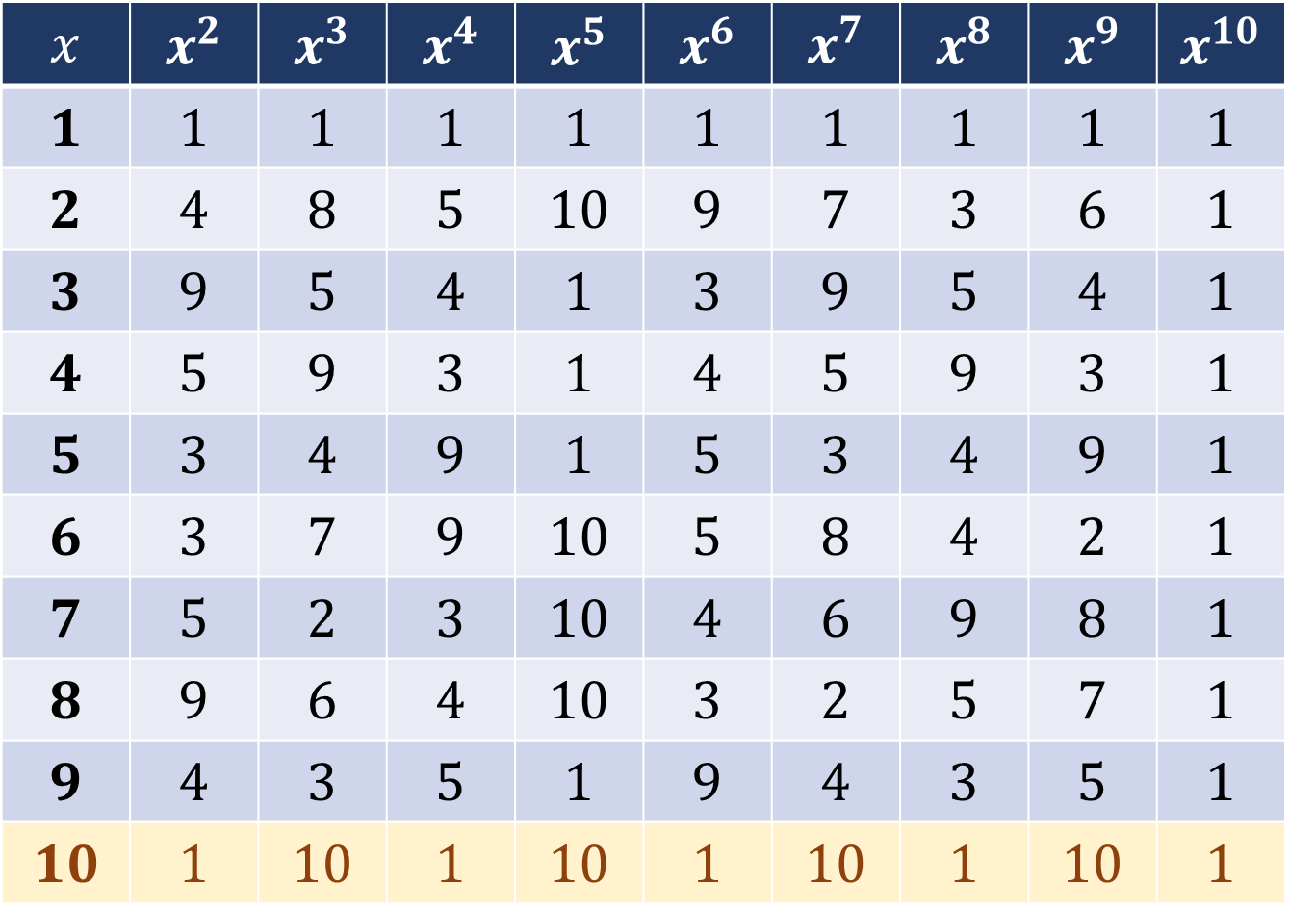

Primitive Roots of Unity
A number $ω$ is a primitive $n$^{th} root of unity, for $n>1$, if
$ω^{n} = 1$
Numbers 1, $ω,ω^{2}, …,ω^{n−1}$ are distinct
10 is $n$^{th} root of unity in $ℤ_{n}^{∗}$ for $n=\{2,4,6,8, 10\}$
$$x$$ | $$x^{2}$$ | $$x^{3}$$ | $$x^{4}$$ | $$x^{5}$$ | $$x^{6}$$ | $$x^{7}$$ | $$x^{8}$$ | $$x^{9}$$ | $$x^{10}$$
$$1$$ | $$1$$ | $$1$$ | $$1$$ | $$1$$ | $$1$$ | $$1$$ | $$1$$ | $$1$$ | $$1$$
$$2$$ | $$4$$ | $$8$$ | $$5$$ | $$10$$ | $$9$$ | $$7$$ | $$3$$ | $$6$$ | $$1$$
$$3$$ | $$9$$ | $$5$$ | $$4$$ | $$1$$ | $$3$$ | $$9$$ | $$5$$ | $$4$$ | $$1$$
$$4$$ | $$5$$ | $$9$$ | $$3$$ | $$1$$ | $$4$$ | $$5$$ | $$9$$ | $$3$$ | $$1$$
$$5$$ | $$3$$ | $$4$$ | $$9$$ | $$1$$ | $$5$$ | $$3$$ | $$4$$ | $$9$$ | $$1$$
$$6$$ | $$3$$ | $$7$$ | $$9$$ | $$10$$ | $$5$$ | $$8$$ | $$4$$ | $$2$$ | $$1$$
$$7$$ | $$5$$ | $$2$$ | $$3$$ | $$10$$ | $$4$$ | $$6$$ | $$9$$ | $$8$$ | $$1$$
$$8$$ | $$9$$ | $$6$$ | $$4$$ | $$10$$ | $$3$$ | $$2$$ | $$5$$ | $$7$$ | $$1$$
$$9$$ | $$4$$ | $$3$$ | $$5$$ | $$1$$ | $$9$$ | $$4$$ | $$3$$ | $$5$$ | $$1$$
$$10$$ | $$1$$ | $$10$$ | $$1$$ | $$10$$ | $$1$$ | $$10$$ | $$1$$ | $$10$$ | $$1$$

Slide 50


Primitive Roots of Unity
A number $ω$ is a primitive $n$^{th} root of unity, for $n>1$, if
$ω^{n} = 1$
Numbers 1, $ω,ω^{2}, …,ω^{n−1}$ are distinct
3, 4, 5 and 9 are 5th roots of unity in in $ℤ_{n}^{∗}$
$$x$$ | $$x^{2}$$ | $$x^{3}$$ | $$x^{4}$$ | $$x^{5}$$ | $$x^{6}$$ | $$x^{7}$$ | $$x^{8}$$ | $$x^{9}$$ | $$x^{10}$$
$$1$$ | $$1$$ | $$1$$ | $$1$$ | $$1$$ | $$1$$ | $$1$$ | $$1$$ | $$1$$ | $$1$$
$$2$$ | $$4$$ | $$8$$ | $$5$$ | $$10$$ | $$9$$ | $$7$$ | $$3$$ | $$6$$ | $$1$$
$$3$$ | $$9$$ | $$5$$ | $$4$$ | $$1$$ | $$3$$ | $$9$$ | $$5$$ | $$4$$ | $$1$$
$$4$$ | $$5$$ | $$9$$ | $$3$$ | $$1$$ | $$4$$ | $$5$$ | $$9$$ | $$3$$ | $$1$$
$$5$$ | $$3$$ | $$4$$ | $$9$$ | $$1$$ | $$5$$ | $$3$$ | $$4$$ | $$9$$ | $$1$$
$$6$$ | $$3$$ | $$7$$ | $$9$$ | $$10$$ | $$5$$ | $$8$$ | $$4$$ | $$2$$ | $$1$$
$$7$$ | $$5$$ | $$2$$ | $$3$$ | $$10$$ | $$4$$ | $$6$$ | $$9$$ | $$8$$ | $$1$$
$$8$$ | $$9$$ | $$6$$ | $$4$$ | $$10$$ | $$3$$ | $$2$$ | $$5$$ | $$7$$ | $$1$$
$$9$$ | $$4$$ | $$3$$ | $$5$$ | $$1$$ | $$9$$ | $$4$$ | $$3$$ | $$5$$ | $$1$$
$$10$$ | $$1$$ | $$10$$ | $$1$$ | $$10$$ | $$1$$ | $$10$$ | $$1$$ | $$10$$ | $$1$$

Slide 51


Primitive Roots of Unity
A number $ω$ is a primitive $n$^{th} root of unity, for $n>1$, if
$ω^{n} = 1$
Numbers 1, $ω,ω^{2}, …,ω^{n−1}$ are distinct
2, 6, 7 and 8 are 10th roots of unity in in $ℤ_{n}^{∗}$
$$x$$ | $$x^{2}$$ | $$x^{3}$$ | $$x^{4}$$ | $$x^{5}$$ | $$x^{6}$$ | $$x^{7}$$ | $$x^{8}$$ | $$x^{9}$$ | $$x^{10}$$
$$1$$ | $$1$$ | $$1$$ | $$1$$ | $$1$$ | $$1$$ | $$1$$ | $$1$$ | $$1$$ | $$1$$
$$2$$ | $$4$$ | $$8$$ | $$5$$ | $$10$$ | $$9$$ | $$7$$ | $$3$$ | $$6$$ | $$1$$
$$3$$ | $$9$$ | $$5$$ | $$4$$ | $$1$$ | $$3$$ | $$9$$ | $$5$$ | $$4$$ | $$1$$
$$4$$ | $$5$$ | $$9$$ | $$3$$ | $$1$$ | $$4$$ | $$5$$ | $$9$$ | $$3$$ | $$1$$
$$5$$ | $$3$$ | $$4$$ | $$9$$ | $$1$$ | $$5$$ | $$3$$ | $$4$$ | $$9$$ | $$1$$
$$6$$ | $$3$$ | $$7$$ | $$9$$ | $$10$$ | $$5$$ | $$8$$ | $$4$$ | $$2$$ | $$1$$
$$7$$ | $$5$$ | $$2$$ | $$3$$ | $$10$$ | $$4$$ | $$6$$ | $$9$$ | $$8$$ | $$1$$
$$8$$ | $$9$$ | $$6$$ | $$4$$ | $$10$$ | $$3$$ | $$2$$ | $$5$$ | $$7$$ | $$1$$
$$9$$ | $$4$$ | $$3$$ | $$5$$ | $$1$$ | $$9$$ | $$4$$ | $$3$$ | $$5$$ | $$1$$
$$10$$ | $$1$$ | $$10$$ | $$1$$ | $$10$$ | $$1$$ | $$10$$ | $$1$$ | $$10$$ | $$1$$

Slide 52


Primitive Roots of Unity: Inverse
A number $α$ is an inverse of $β$ if $αβ \text{mod} n=1$
Examples:
2⁻¹=6,
3⁻¹=4,
4⁻¹=3,
5⁻¹=9,
6⁻¹=2,
7⁻¹=8,
8⁻¹=7,
9⁻¹=5
$$x$$ | $$x^{2}$$ | $$x^{3}$$ | $$x^{4}$$ | $$x^{5}$$ | $$x^{6}$$ | $$x^{7}$$ | $$x^{8}$$ | $$x^{9}$$ | $$x^{10}$$
$$1$$ | $$1$$ | $$1$$ | $$1$$ | $$1$$ | $$1$$ | $$1$$ | $$1$$ | $$1$$ | $$1$$
$$2$$ | $$4$$ | $$8$$ | $$5$$ | $$10$$ | $$9$$ | $$7$$ | $$3$$ | $$6$$ | $$1$$
$$3$$ | $$9$$ | $$5$$ | $$4$$ | $$1$$ | $$3$$ | $$9$$ | $$5$$ | $$4$$ | $$1$$
$$4$$ | $$5$$ | $$9$$ | $$3$$ | $$1$$ | $$4$$ | $$5$$ | $$9$$ | $$3$$ | $$1$$
$$5$$ | $$3$$ | $$4$$ | $$9$$ | $$1$$ | $$5$$ | $$3$$ | $$4$$ | $$9$$ | $$1$$
$$6$$ | $$3$$ | $$7$$ | $$9$$ | $$10$$ | $$5$$ | $$8$$ | $$4$$ | $$2$$ | $$1$$
$$7$$ | $$5$$ | $$2$$ | $$3$$ | $$10$$ | $$4$$ | $$6$$ | $$9$$ | $$8$$ | $$1$$
$$8$$ | $$9$$ | $$6$$ | $$4$$ | $$10$$ | $$3$$ | $$2$$ | $$5$$ | $$7$$ | $$1$$
$$9$$ | $$4$$ | $$3$$ | $$5$$ | $$1$$ | $$9$$ | $$4$$ | $$3$$ | $$5$$ | $$1$$
$$10$$ | $$1$$ | $$10$$ | $$1$$ | $$10$$ | $$1$$ | $$10$$ | $$1$$ | $$10$$ | $$1$$

Slide 53

Primitive Roots of Unity
$n$^{th} root of unity is a complex number
$$e^{{2πι}/n}=\text{cos}\left({2π}/n\right)+ι \text{sin}\left({2π}/n\right)$$
All $n$^{th} roots are equally spaced on unity circle.
$$ω= ω^{1}=e^{2πι/n} ≠1$$
$$ω^{k}={e^{\left(\frac{2π ι}{n}\right)}}^{k}=e^{\left(\frac{2πk ι}{n}\right)}=\cos\left({2πk}/n\right)+\text{sin}\left({2πk}/n\right)$$
$$ω^{n}=e^{\left(\frac{2πn}{n}\right)ι}=e^{2πι}=1$$
$$ω^{n}−1=\left(ω−1\right)\left(ω^{1}+ω^{2}+ω^{3}+…ω^{n−1}\right)=0$$
$$ω^{1}+ω^{2}+ω^{3}+…ω^{n−1}=0$$

Slide 54



Square Roots of Unity $\left(\sqrt{1}\right)$
$$ω=−1$$
$$ω^{2}=1$$

Slide 55








Cubic Roots of Unity $\left(\sqrt[3]{1}\right)$
$$ω^{1}=cos\left(π/4\right){+ι}sin(π/4)⁡$$
$$ω^{1}$$
$$ω^{1}=\text{cos}\left(120°\right)+i \text{sin}\left(120°\right)= \frac{−1+\sqrt{3} ι}{2}$$
120º
$$ω^{3}=1$$
$$ω^{2}=\text{cos}\left(−120°\right)+i \text{sin}\left(−120°\right)= \frac{−1−\sqrt{3} ι}{2}$$
$$ω^{1} \text{and} ω^{2 }\text{are} \text{complex} \text{conjugates}\text{.}$$
$$ω^{1}=ω^{2∗}\text{and}{ ω}^{2}=ω^{1∗}$$
$$ω^{2}$$

Slide 56





4th Roots of Unity $\left(\sqrt[4]{1}\right)$
$$ω^{1}=ι$$
$$ω^{4}=1$$
$$ω^{2}=−1$$
$$ω^{3}=−ι$$

Slide 57








6th Roots of Unity $\left(\sqrt[6]{1}\right)$
$$ω^{2}$$
$$ω^{1}=cos\left(π/3\right){+ι}sin\left(π/3\right)=\frac{1+\sqrt{3} ι}{2}$$
$$ω^{2}=−cos\left(π/3\right){+ι}sin\left(π/3\right)=\frac{−1+\sqrt{3 }ι}{2}$$
$$ω^{3}=−1$$
$$ω^{4}=−cos\left(π/4\right){−ι}sin\left(π/4\right)=\frac{−1−\sqrt{3 }ι}{2}$$
$$ω^{5}=cos\left(π/4\right){−ι}sin\left(π/4\right)=\frac{1−\sqrt{3} ι}{2}$$
$$ω^{6}=1$$
$$⁡$$
$$ω^{1}$$
60º
$$ω^{3}$$
$$ω^{6}$$
$$ω^{4}$$
$$ω^{5}$$

Slide 58










8th Roots of Unity $\left(\sqrt[8]{1}\right)$
$$ω^{2}$$
$$ω^{1}=cos\left(π/4\right){+ι}sin\left(π/4\right)=\frac{1+ι}{\sqrt{2}}$$
$$ω^{2}=ι$$
$$ω^{3}=−cos\left(π/4\right){+ι}sin\left(π/4\right)=\frac{−1+ι}{\sqrt{2}}$$
$$ω^{4}=−1$$
$$ω^{5}=−cos\left(π/4\right){−ι}sin\left(π/4\right)=\frac{−1−ι}{\sqrt{2}}$$
$$ω^{6}=−ι$$
$$ω^{7}=cos\left(π/4\right){−ι}sin\left(π/4\right)=\frac{1−ι}{\sqrt{2}}$$
$$ω^{8}=1$$
$$⁡$$
$$ω^{1}$$
$$ω^{3}$$
45º
$$ω^{8}$$
$$ω^{4}$$
$$ω^{7}$$
$$ω^{5}$$
$$ω^{6}$$

Slide 59

Properties: Primitive Roots of Unity
Inverse Property: $ω.ω^{n−1}=ω^{n}=1⇒ω^{−1}=ω^{n−1}$
Cancellation Property: For non-zero $−n<k<n$,
$$\sum_{q=0}^{n−1}{ω^{kq}=\sum_{q=0}^{n−1}{φ^{q}}=φ^{0}+φ^{1}+…+φ^{n−1}=\frac{φ^{n}−1}{φ−1}=\frac{ω^{nk}−1}{ω^{k}−1}=\frac{1^{k}−1}{ω^{k}−1}=0}$$
$$\sum_{q=0}^{n−1}{ω^{kq}=0}$$
Reduction Property: $ω=\sqrt[2n]{1}$ i.e. primitive $2n$^{th} root of unity, then $ω^{2}=\sqrt[n]{1}$ i.e primitive $n$^{th} root of unity.
Reflective Property: If $n$ is even, then $ω^{n/2}=−1$.
Corollary: $ω^{k+n/2}=$ $ω^{k} ω^{n/2}$= − $ω^{k}$.

